Slide 1
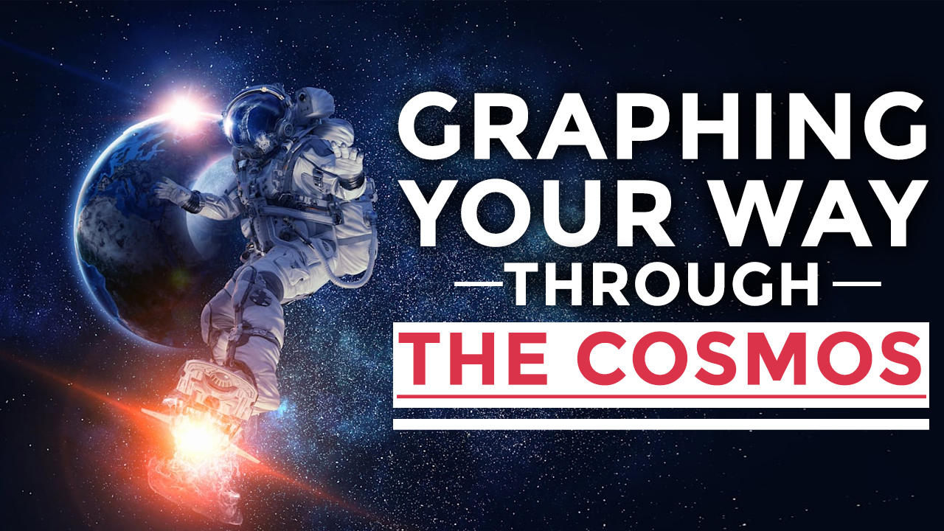

Slide 2
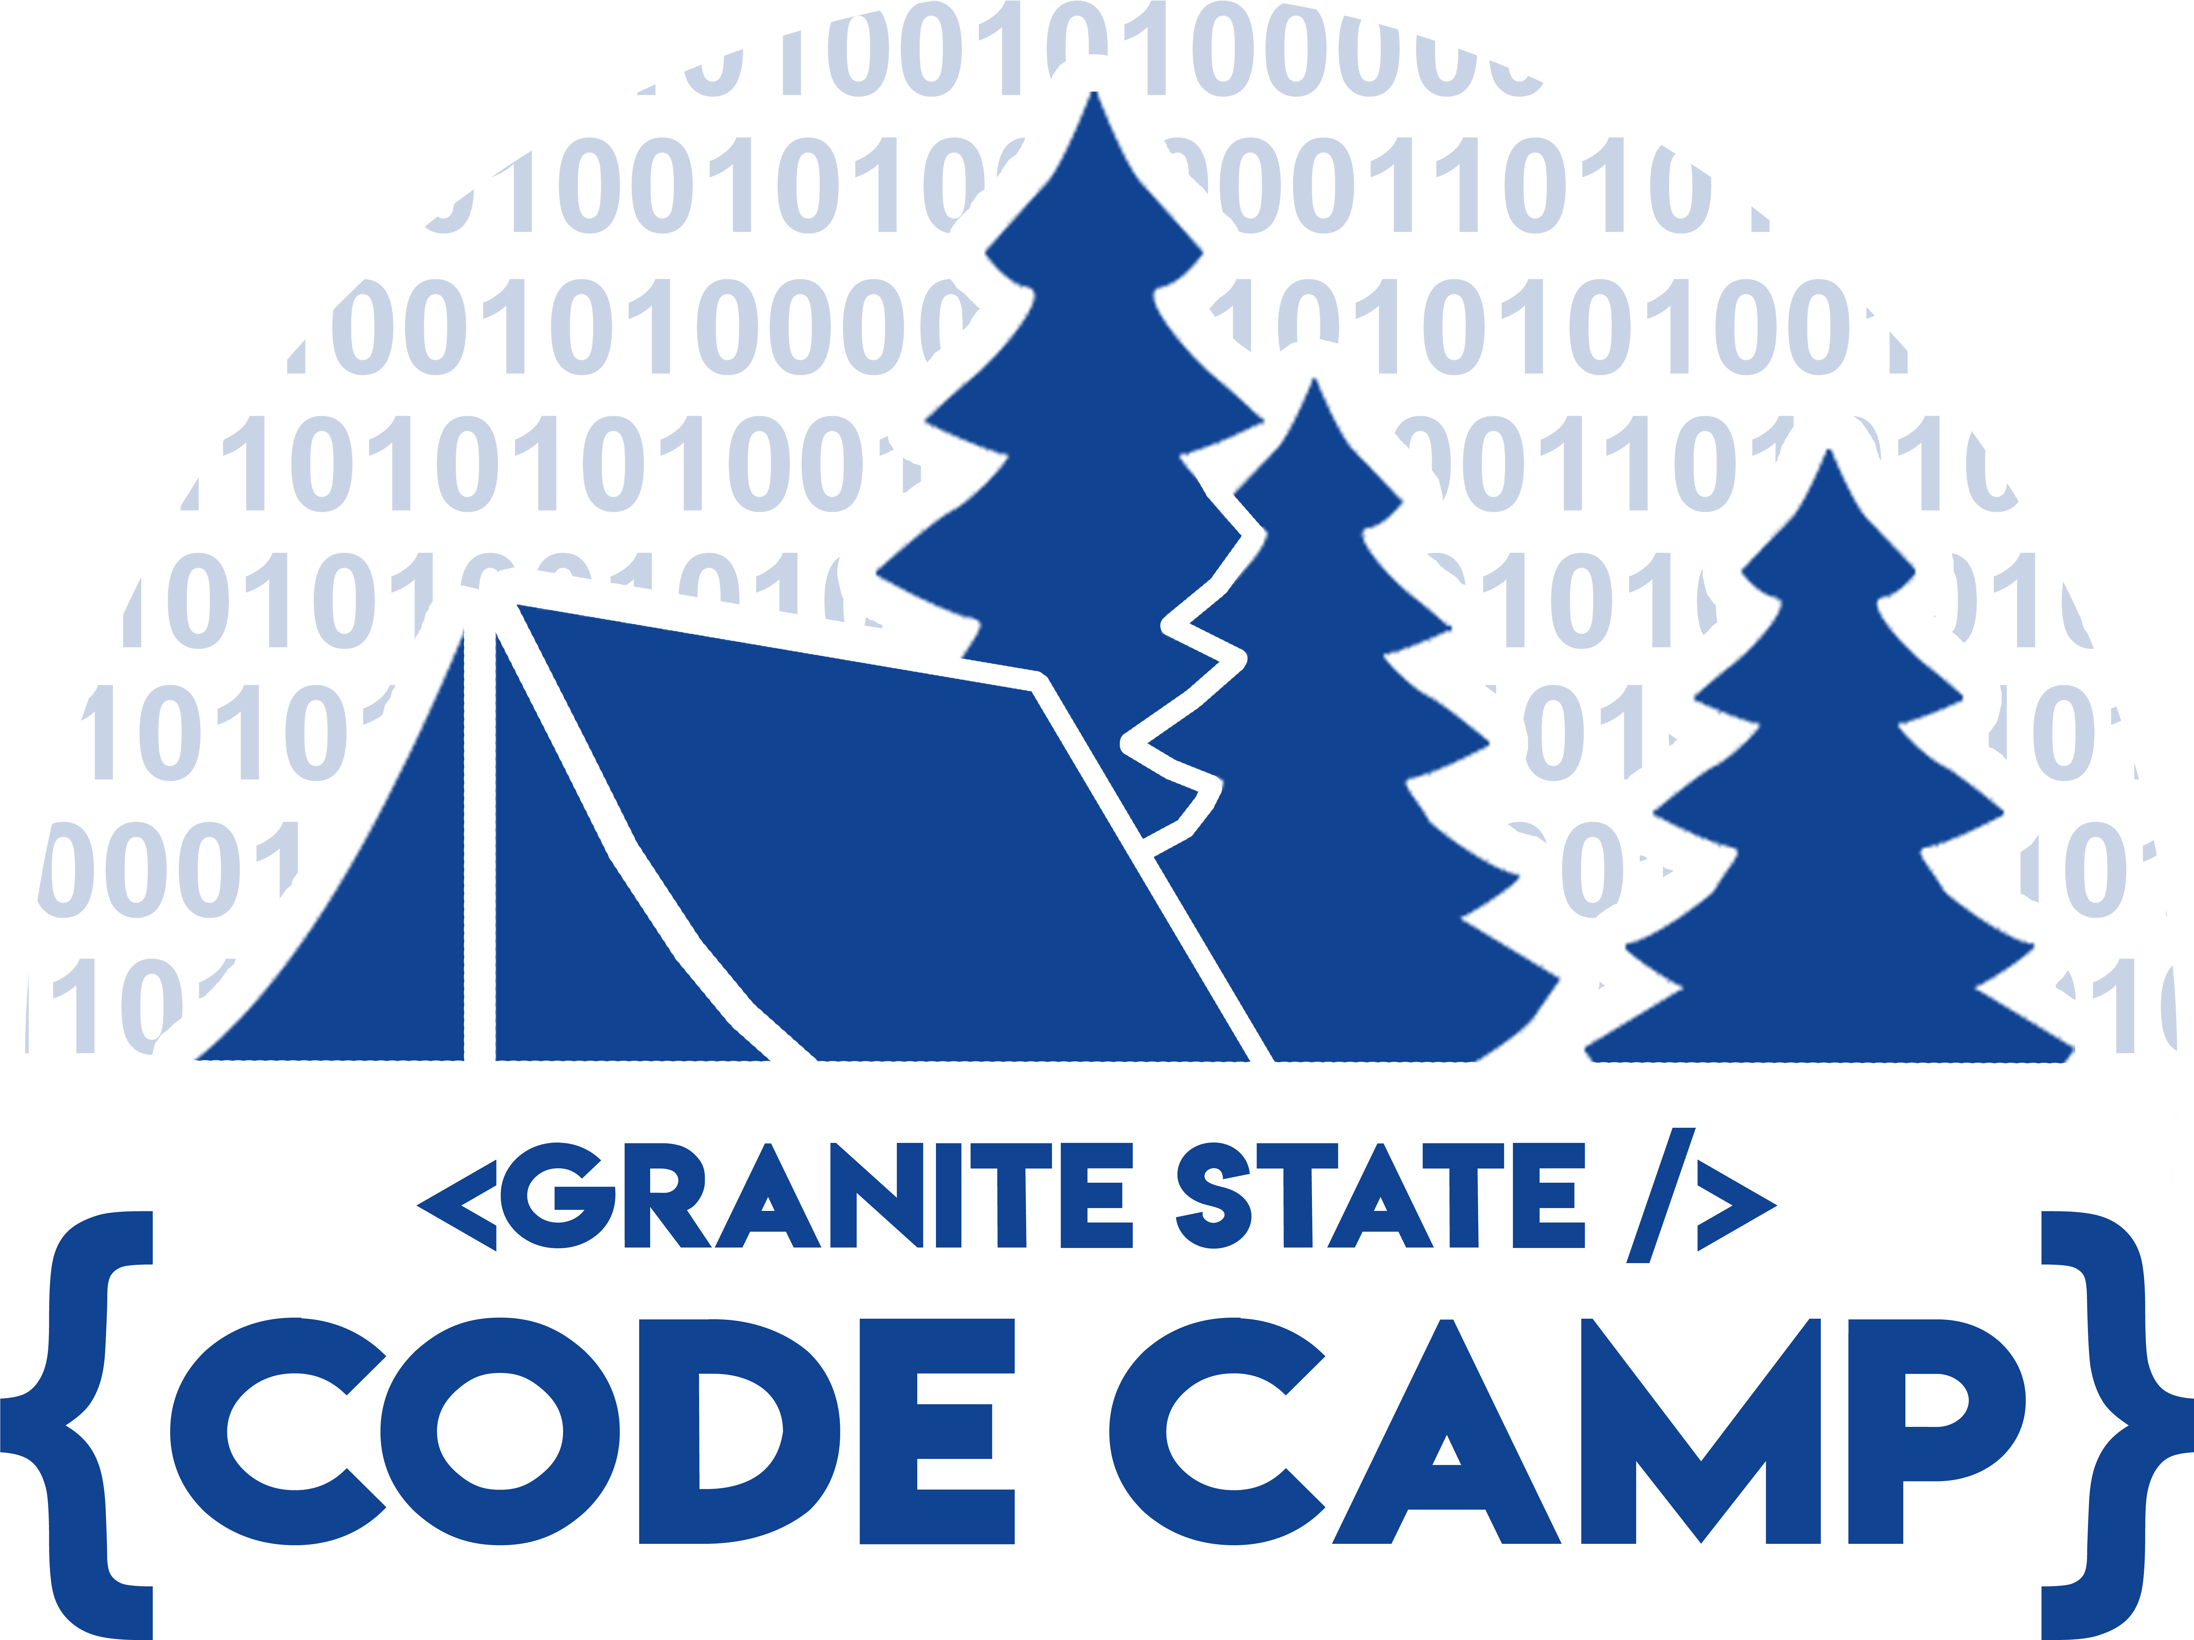





A BIG thank you to our 2020 Sponsors!
Platinum Sponsor (Londonderry)
Gold Sponsor (Portsmouth)
Gold Sponsor (Plymouth)
Bronze Sponsor
Bronze Sponsor

Slide 3
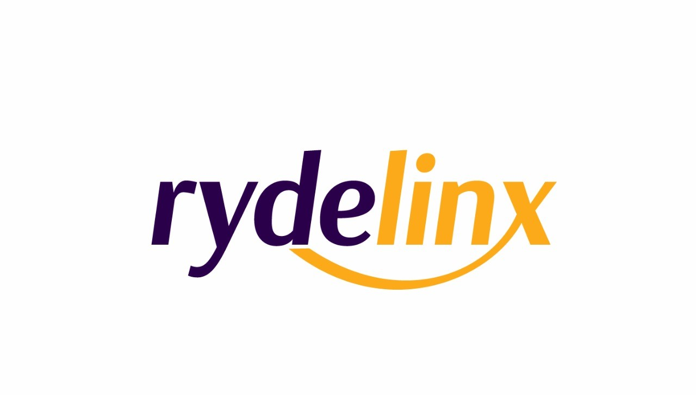



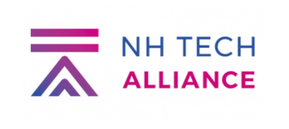
Another BIG thank you to supporting organizations!
This event was also made manageable by these organizations in support of free, grass-roots events like Granite State Code Camp 2020

Slide 4
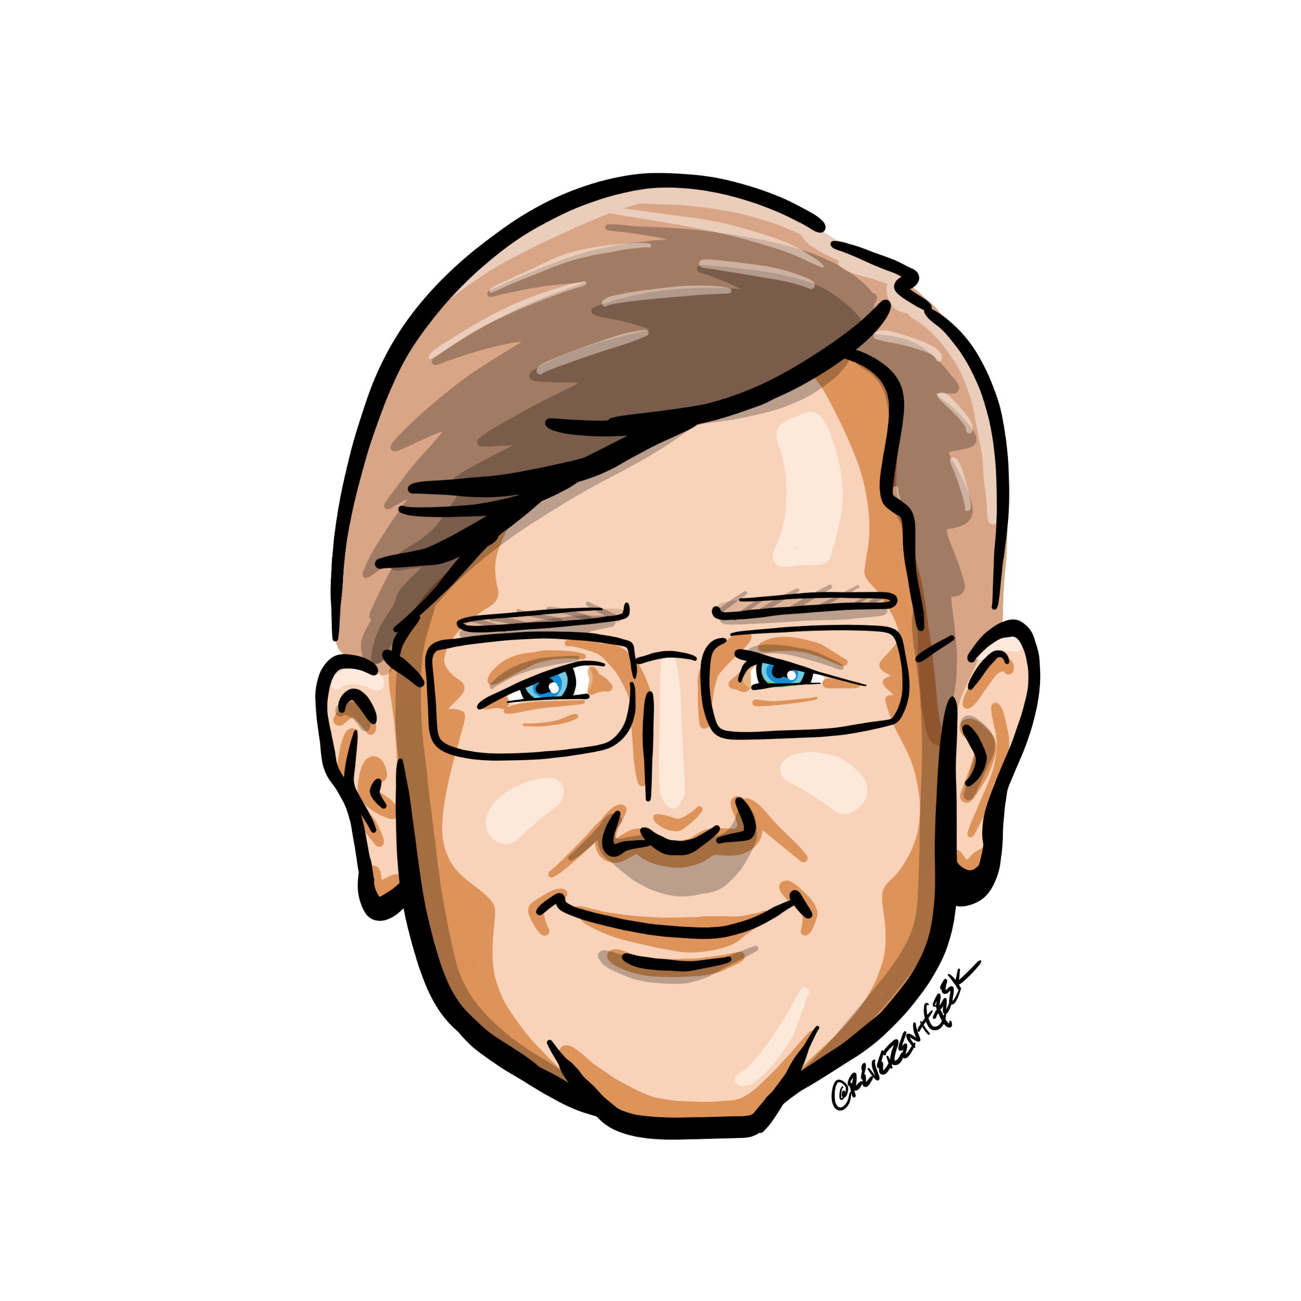





Who is Chad Green
chadgreen@chadgreen.com
TaleLearnCode
TaleLearnCode.com
ChadGreen & TaleLearnCode
ChadwickEGreen

Slide 5
What are Graph Databases
Graphing Your Way Through the Cosmos

Slide 6
What is a Graph
Structure amounting to set of objects in which some pares of the objects are in some sense related
Notes:
Graphs are one of the areas of concentration in discrete mathematics; discrete mathematics is the study of mathematical structures that are fundamentally discrete rather than continuous
-------------------
By definition, a graph is a structure amounting to a set of objects in which some pairs of the objects are in some sense related.
-------------------
The objects correspond to mathematical abstractions called vertices and each of the related pairs of vertices is called an edge.
Vertices are also called nodes or points.
Edges are also called links, lines, or relationships.
-------------------
Graphs are the basic subjected studied by graph theory.

Slide 7
What is a Graph
Notes:
Typically, a graph is depicted in diagrammatic form as a set of dots or circles for the vertices, joined by lines or curves for the edges

Slide 8
What is a Graph
G = (V, E)
Notes:
A graph is an ordered pair using the equation G = (V, E)
V is a set of vertices
E is a set edges which are unordered pairs of vertices (i.e., an edge is associated with two distinct vertices)
V – set whose elements are called vertices
E – Set of two-sets (set with two distinct elements) of vertices, whose elements are called edges

Slide 9
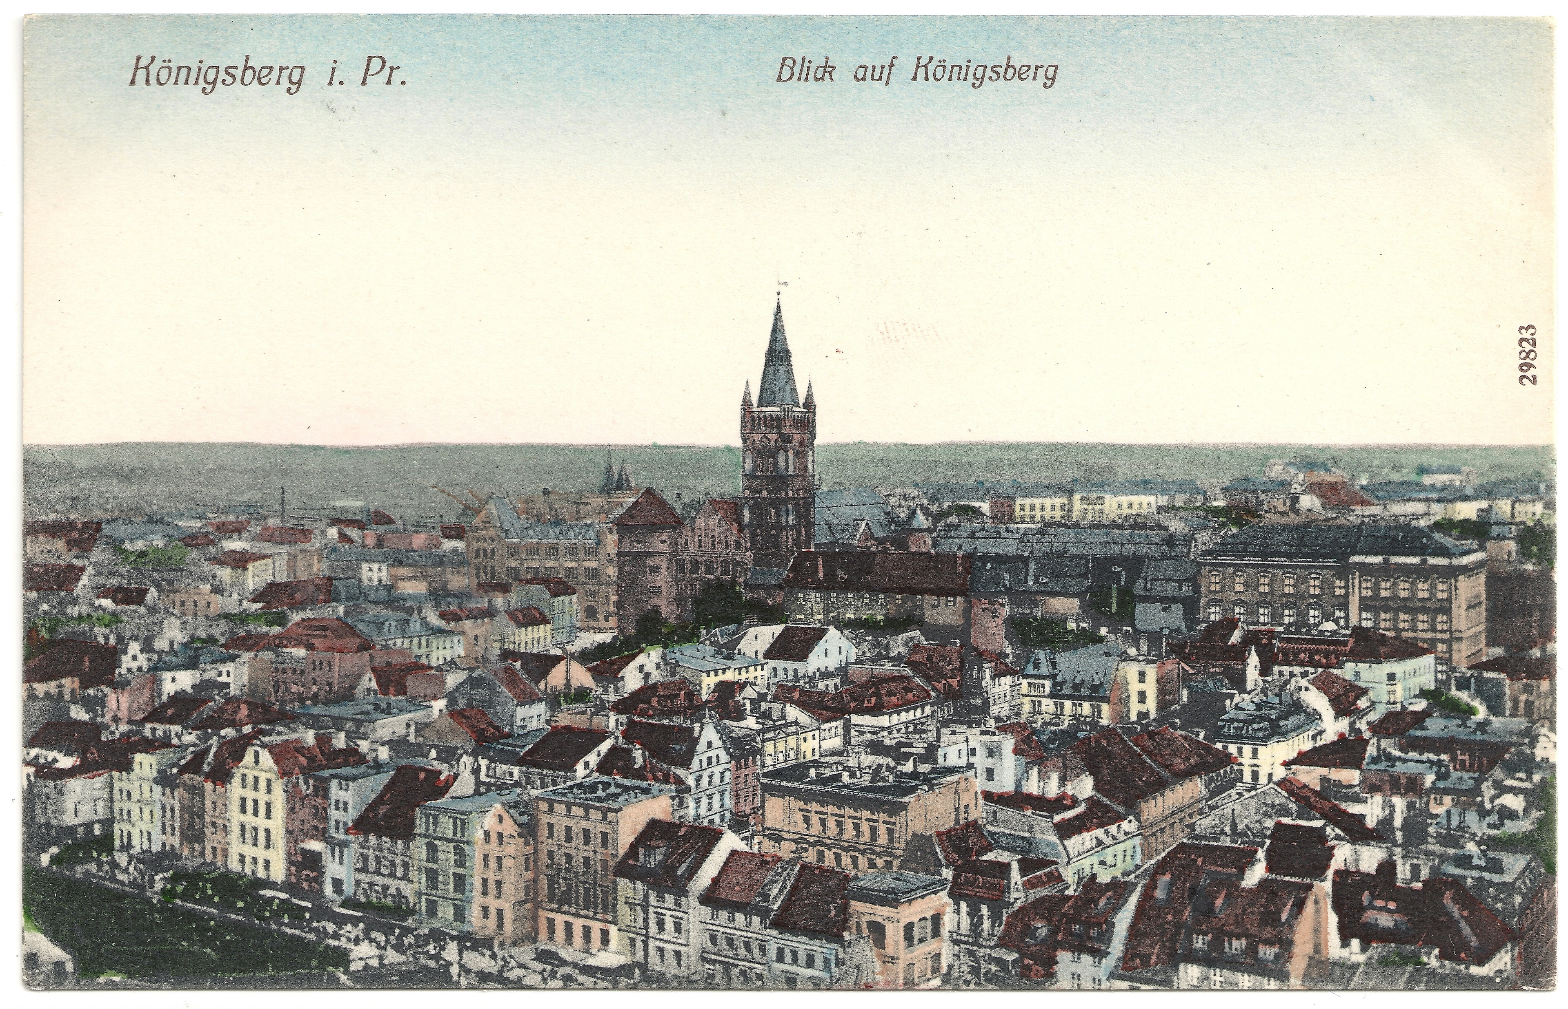
History Graph Theory
Notes:
Our story begins in the 18th century, in the quaint town of Königsberg, Prussia on the banks of the Pregel River. In 1254, Teutonic knights founded the city of Königsberg under the lead of Bohemian King Ottoker II after their second crusade against the Prussians. In the Middle Ages, Königsberg became a very important city and trading center with its location strategically positioned on the river. Artwork from the eighteenth century shows Königsberg as a thriving city, where fleets of ships fill the Pregel, and their trade offers a comfortable lifestyle to both the local merchants and their families. The healthy economy allowed the people of the city to build seven bridges across the river, most of which connected to the island of Kneiphof.

Slide 10
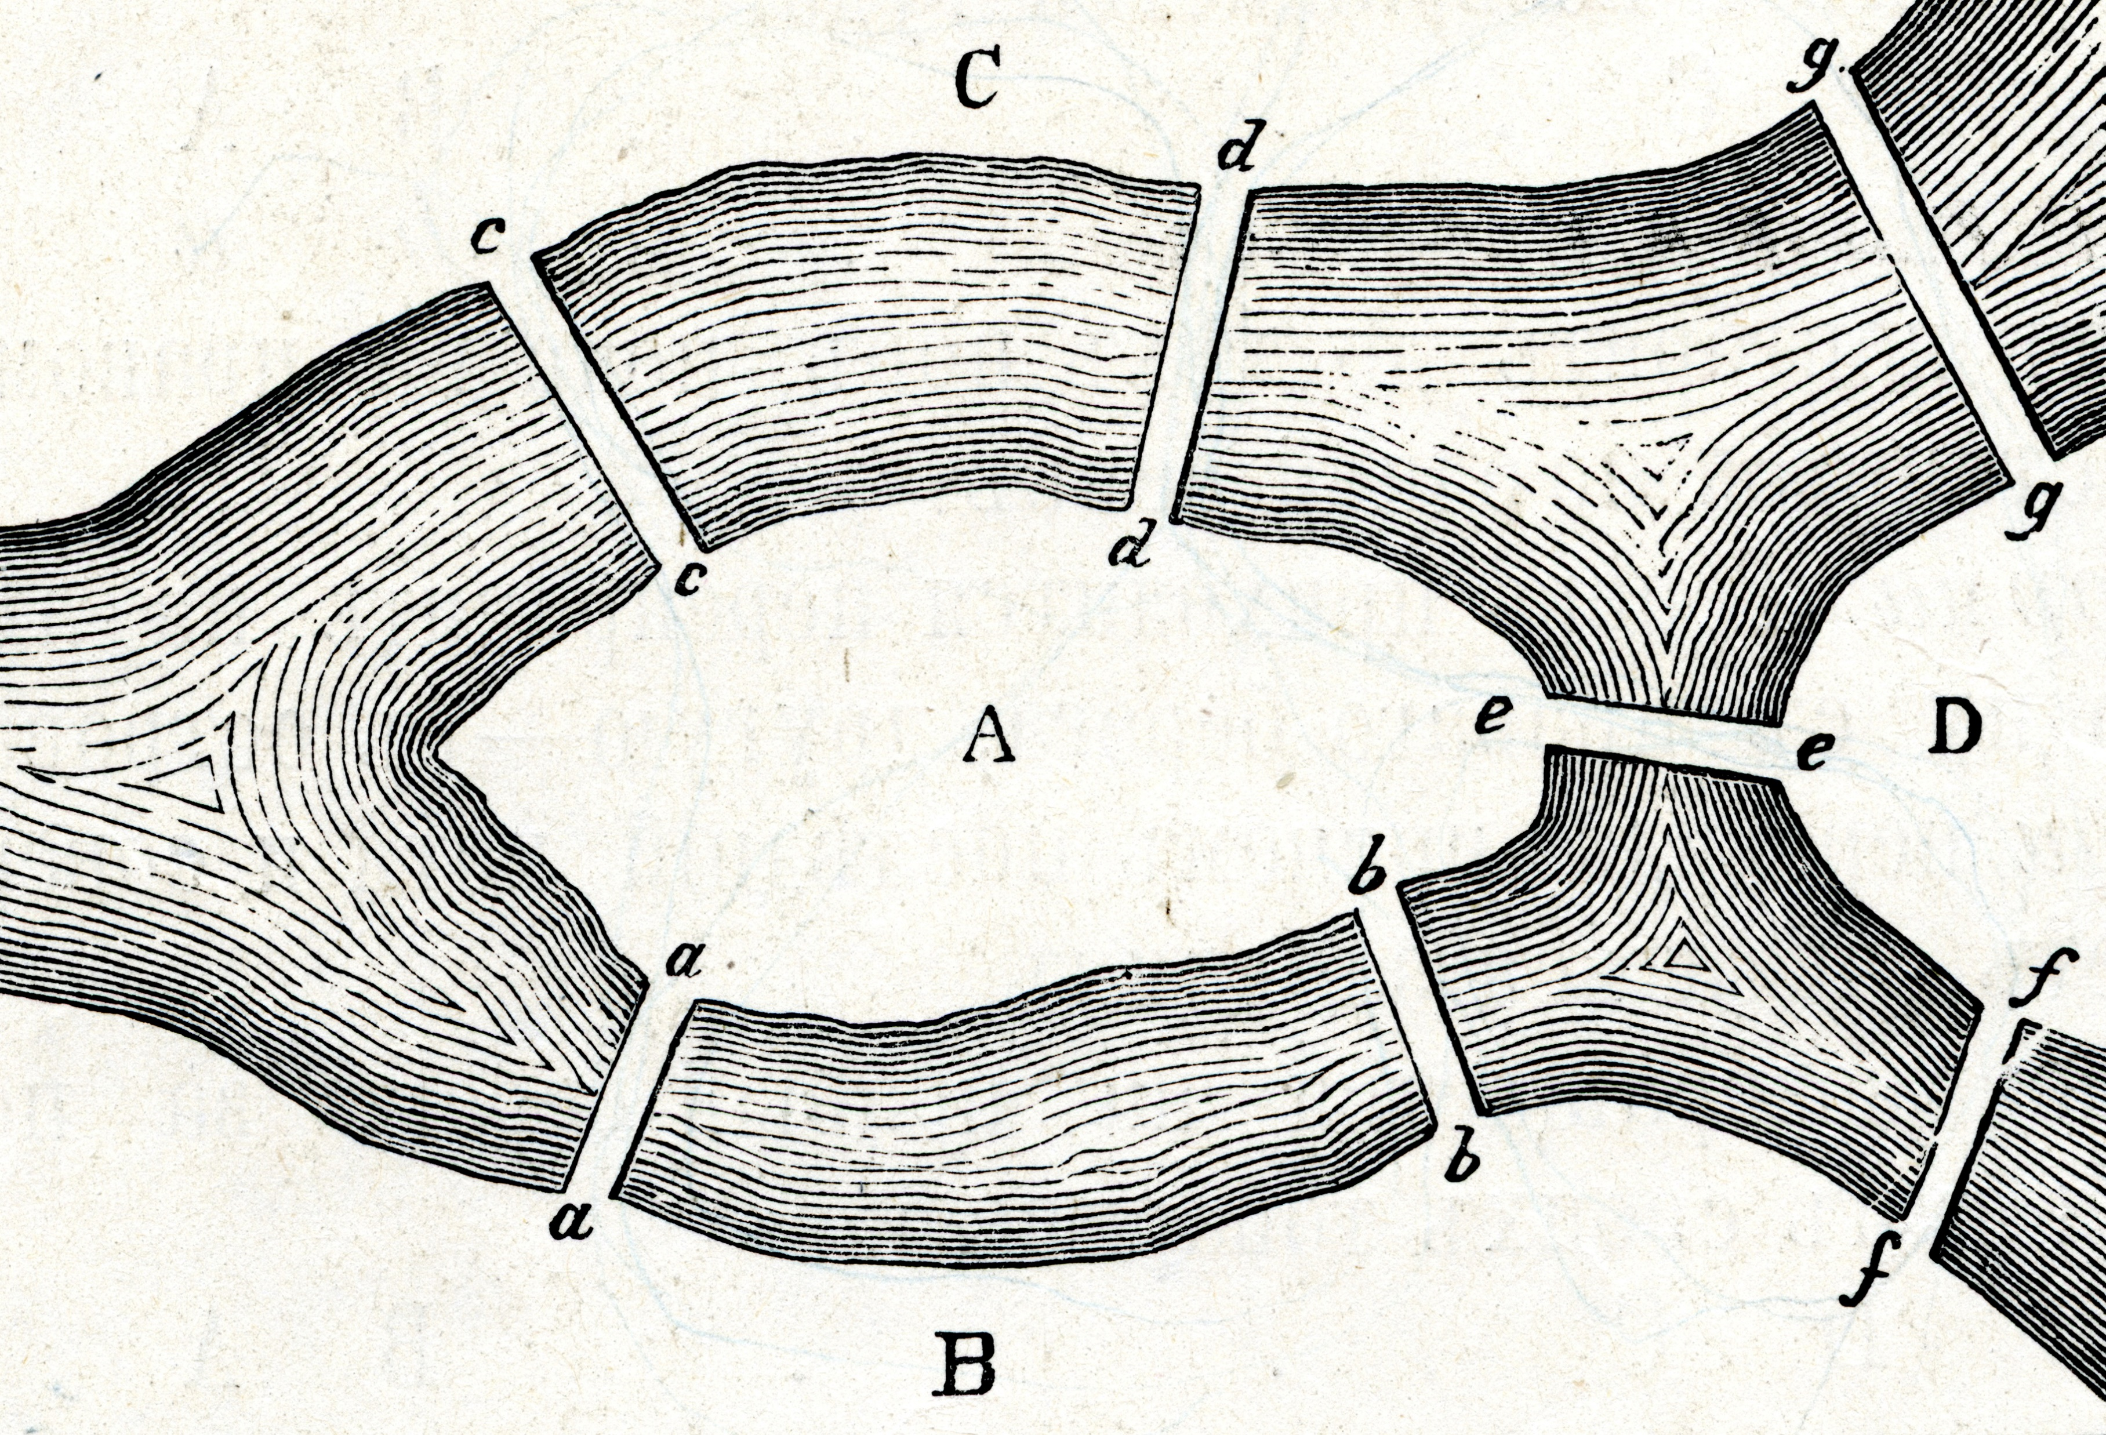
History Graph Theory
Notes:
As the river flowed around Kneiphof and another island, it divided the city into four distinct regions. According to lore, the citizens of Königsberg used to spend Sunday afternoons walking around their beautiful city. While walking, the people of the city decided to create a game for themselves, their goal being to devise a way in which they could walk around the city, crossing each of the seven bridges only once. Even though none of the citizens of Königsberg could invent a route that would allow them to cross each of the bridges only once, still they could not prove that it was impossible.

Slide 11
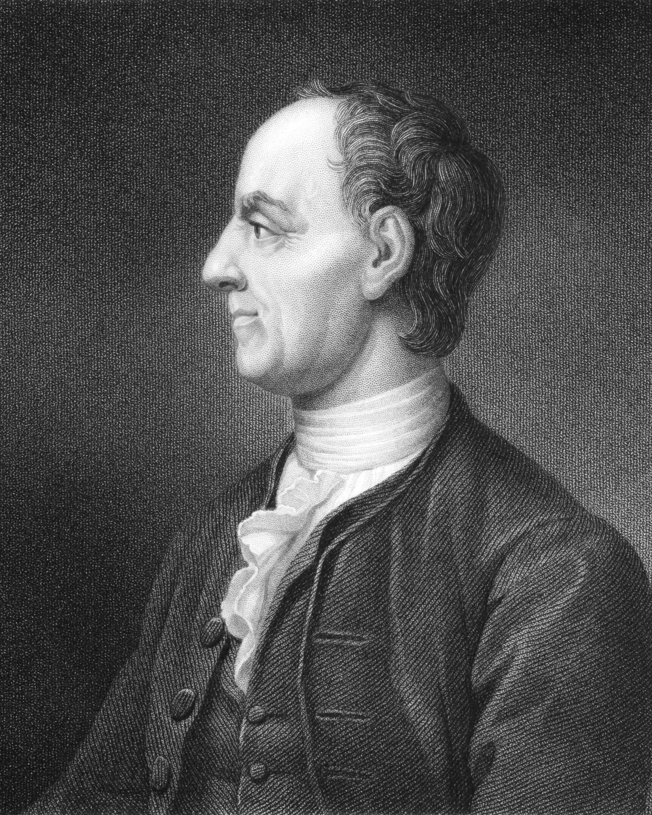
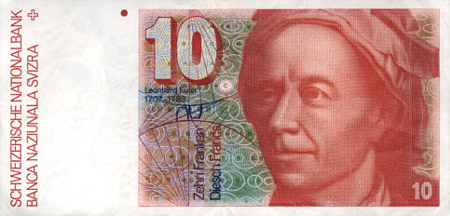
History Graph Theory
Leonard Euler
Notes:
Lucky for them, Königsberg was not too far from St. Petersburg, home of the famous mathematician Leonard Euler.
Euler was a very prolific mathematician who published more than 500 books and papers during his lifetime. In 1775 alone, he wrote an average of one mathematical paper per week, and during his lifetime he wrote on not just mathematics but also mechanics, optics, astronomy, navigation, and hydrodynamics. He is so well respected, that he was depicted on the Swiss 10 Franc bill.
The mayor wrote to Euler to ask for help, but originally Euler refused saying that this was a trivial problem not requiring a mathematician to solve.

Slide 12
History Graph Theory
Solutio problematis ad geometriam situs pertinentis
The solution of a problem relating to the geometry of position
Notes:
Euler presents a paper to the St. Petersburg Academy on August 26, 1735 containing the solution the Königsberg bridge problem. He addresses both this specific problem as well as a general solution with any number of landmasses and any number of bridges. This paper entitled Solutio problematis ad geometriam situs pertinentis (The solution of a problem relating to the geometry of position) was published in 1741.
This is generally considered the beginning of graph theory.

Slide 13
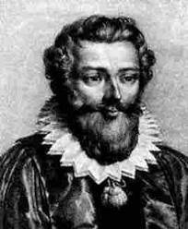
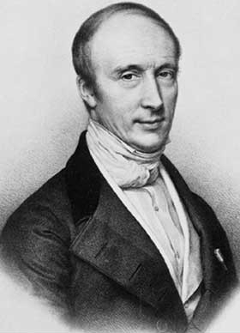
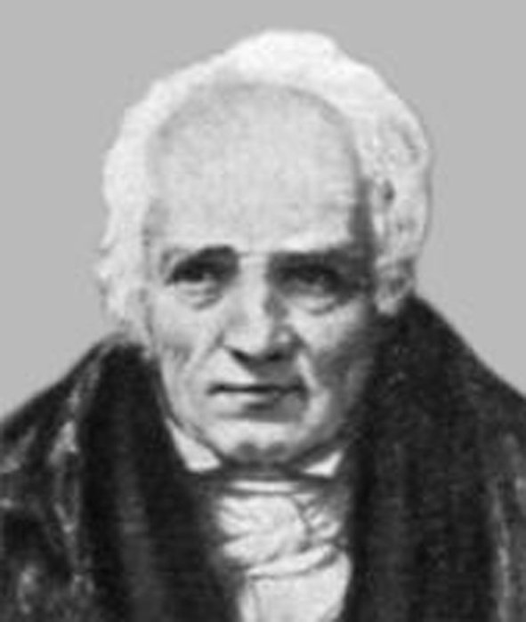
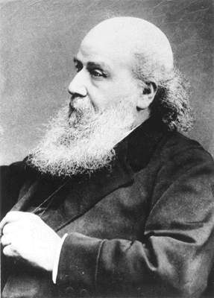
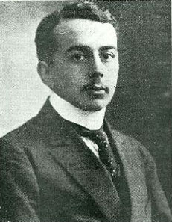
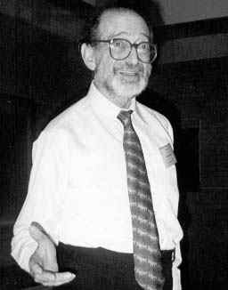
History Graph Theory
Notes:
Alexandre-Théophile Vandermonde publishes paper on the knight problem
Augustin-Louis Caunchy & Simon Antoine Jean L’Huilier used Euler’s formula to begin topology
Term “graph” introduced in 1878 by James Joseph Sylvester
First textbox on graph theory written by Dénes Kőnig in 1936
In 1969, Frank Harary publishes the “definitive textbook on the subject"
Knight Problem is finding the sequence of moves of a knight on a chessboard such that the knight visits every square once.
Topology is concerned with the properties of space that are preserved under continuous deformations, such as stretching, twisting, crumpling, and bending, but not tearing or gluing.
Harary’s book enabled mathematicians, chemists, electrical engineers, and social scientists to talk to each other

Slide 14
Application of Graph Theory
Linguistics
Physics and Chemistry
Social Sciences
Biology
Computer Science
Notes:
Linguistics: Graph-theoretic methods, in various forms, have proven particularly useful in linguistics, since natural language often lends itself well to discrete structure. Contemporary approaches such as head-driven phrase structure grammar model the syntax of natural language using typed feature structures, which are directed acyclic graphs. Within lexical semantics, especially as applied to computers, modeling word meaning is easier when a given word is understood in terms of related words; semantic networks are therefor in computational linguistics.
Physics and Chemistry: Graph theory is used to study molecules in chemistry and physics.
Social Sciences: Graph theory is used widely in sociology as a way to measure actors’ prestige or to explore rumor spreading, notably through the use of social network analysis software. Acquaintanceship and friendship graphs describe whether people know each other. Influence graphs model whether certain people can influence the behavior of others. Collaboration graphs model whether two people work together in a particular way, such as acting in a movie together.
Biology: Graph theory is useful in biology and conservation efforts where a vertex can represent regions where certain species exist (or inhabit) and the edges represent migration paths or movements between the regions. This information is important when looking at breeding patterns or tracking the spread of disease, parasites, or how changes to the movement can affect other species.
Computer Science: Graphs are used to represent networks of communications, data organization, computational devices, the flow of computation, etc. For instance, the link structure of a website can be represented by a directed graph, in which the vertices represent web pages and directed edges represent links from one page to another. A similar approach can be taken to problems in social media, travel, biology, computer chip design, mapping the progression of neuro-degenerative diseases, and many other fields.

Slide 15

Notes:
NO MORE MATH TALK

Slide 16
What is a Graph
Allows us to model all kinds of scenarios
Notes:
Let’s take a look at the What is a Graph question again, but this time keep it to just data.
Formally, a graph is just a collection of vertices and edges – or, in less formal language, a set of nodes and the relationships that connect them.
Graphs represent entities as vertices and the ways in which those entities relate to the world as relationships (or edges).
This general-purpose, expressive structure allows us to model all kinds of scenarios

Slide 17
What is a Graph
Notes:
Twitter represented in a graph

Slide 18
What is a Graph Database
Database that uses graph structures to represent and store data

Slide 19
What is a Graph Database
Represents data as it exits in the real world as they are naturally connected
Notes:
A graph database, as opposed to a relational database, represents data as it exists in the real world, such as people, cars, computers, and so on, that are naturally connected
And does not try to change them in any way to define them as entities
Does not try to change them in any way to define them as entities

Slide 20
What is a Graph Database
Vertices represent objects
Edges represent relationships
Vertices and Edges can have any number of properties
Notes:
Graphs are composed of vertices and edges
Vertices represent specific objects such as a person, place, or event
An edge is a relation between vertices.
Both vertices and edges can have any number of properties
Graphs are very useful to understand a wide range of datasets in different fields such as science and business. Graph databases let you work with graphs naturally and efficiently, and they typically are NoSQL because of their ability to adjust quickly to new or updated schemas.
Graphs allow you to work with data in a powerful way by leveraging graph traversals found in many use cases and patterns because they outperform traditional SQL and NoSQL databases by several order of magnitude. Also, they open the door to querying in a natural way of speaking, such as “find the names of the students that attended the Chicago Bulls basketball exhibition game last summer.”

Slide 21
Property Graph Model
Contains nodes (vertices) and relationships (edges)
Nodes and relationships contain properties
Relationships are named and directed with a start and end node
Name: Chad Green
Location: Louisville, KY
Title: Director of IT Architecture
Name: Atria Senior Living
Location: Louisville, KY
Employee
Company
Works For
Date of Employment: 11/2/2020

Slide 22
The Power of Graph Databases
Performance
Flexibility
Agility
Notes:
Notwithstanding the fact that just about anything can be modeled as a graph; that a graph database provides a powerful but novel data modeling technique does not itself provide sufficient justification for replacing a well-established, well-understood data platform; there must also be an immediate and very significant practical benefit. In the case of graph databases, this motivation exists in the form of a set of use cases and data patterns whose performance improves by one or more orders of magnitude when implemented in a graph, and whose latency is much lower compared to batch processing of aggregates. On top of this performance benefit, graph databases offer an extremely flexible data model, and mode of delivery aligned with today’s agile software delivery practices.
Performance
One compelling reason for choosing a graph database is the sheer performance increase when dealing with connected data verses relational databases and NOSQL stores. In contrast to relational databases, where join-intensive query performance deteriorates as the dataset gets bigger, with a graph database performance tends to remain relatively constant, even as the dataset grows. This is because queries are localized to a portion of the graph. As a result, the execution time for each query is proportional only to the size of the part of the graph traversed to satisfy that query, rather than the size of the overall graph
Flexibility
As developers and data architects, we want to connect data as the domain dictates, thereby allowing structure and schema to emerge in tandem with our growing understanding of the problem space, rather than being imposed upfront, when we know least about the real shape and intricacies of the data. Graph databases address this want directly. The graph data model expresses and accommodates business needs in a way that enables IT to move at the speed of business.
Agility
We want to be able to evolve our data model in step with the rest of our application, using a technology aligned with today’s incremental and iterative software delivery practices. Modern graph databases equip us to perform frictionless development and graceful system maintenance. In particular, the schema-free nature of the graph data model, coupled with the testable nature of the graph database’s API and query language, empower us to evolve an application in a controlled manner.
At the same time, precisely because they are schema free, graph databases lack the kind of schema-oriented data governance mechanisms we are familiar with in the relational world. But this is not a risk; rather it calls forth a far more visible and actionable kind of governance. Governance is typically applied in a programmatic fashion, using tests to drive out the data model and queries, as well as assert the business rules that depend upon the graph.

Slide 23
Common Graph Use Cases
Internet of Things
Asset Management
Recommendations
Recommendations
Fraud Detection
Fraud Detection
Data Integration
Identity and Access Management
Identity and Access Management
Social Networks
Social Networks
Communication Networks
Communication Networks
Genomics
Epidemiology
Sematic Web
Search
Search
Notes:
Social Networks – Facebook; Twitter
Recommendations – Amazon
Communication networks – Map entire communications or IT networks and start to run complex scenario testing to prepare for outages better
Fraud detection – can spot the connections between large data sets and identify patterns
Search – Google?; many other examples
Identity and access management – Microsoft Graph

Slide 24
Graph vs Relational
Graphing Your Way Through the Cosmos

Slide 25
Graph vs Relational
Relational
Tables
Schema with nullables
Relations with foreign keys
Related data fetched with joins
Graph
Vertices (Nodes)
No schema
Relation is first class citizen
Related data fetched with a pattern

Slide 26

Human Resource Data
Graph Databases vs Relational Databases

Slide 27
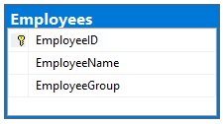
Human Resource Data
Graph vs Relational
EmployeeId | EmployeeName | EmployeeGroup
1 | Willis B. Hawkins | Sales
2 | Neil S. Vega | Sales
3 | Ada C. Lavigne | Engineering

Slide 28
Human Resource Data
Graph vs Relational
-- Create the Employee Table
CREATE TABLE Employees
(
EmployeeID INT IDENTITY(1,1),
EmployeeName VARCHAR(64),
EmployeeGroup VARCHAR(32),
CONSTRAINT pkcEmployees PRIMARY KEY CLUSTERED (EmployeeId)
)
GO
-- Populate the Employee Table
INSERT INTO Employees (EmployeeName, EmployeeGroup)
VALUES ('Willis B. Hawkins', 'Sales'),
('Neil S. Vega', 'Sales'),
('Ada C. Lavigne', 'Engineering');
GO

Slide 29
Human Resource Data
Graph vs Relational
// Create group nodes
g.addV('group').property('id', 'Sales’)
g.addV('group').property('id', 'Engineering’)
// Create employee nodes
g.addV('employee').property('id', 'Willis B. Hawkins’)
g.addV('employee').property('id', 'Neil S. Vega’)
g.addV('employee').property('id', 'Ada C. Lavigne’)
// Create relationships between groups and employees
g.V('Sales').addE('member').to(g.V('Willis B. Hawkins’))
g.V('Sales').addE('member').to(g.V('Neil S. Vega’))
g.V('Engineering').addE('member').to(g.V('Ada C. Lavignee'))

Slide 30
Human Resource Data
Graph vs Relational
EmployeeId | EmployeeName | EmployeeGroup
1 | Willis B. Hawkins | Sales
2 | Neil S. Vega | Sales
3 | Ada C. Lavigne | Engineering
3 rows, 3 columns
8 documents (vertices and edges)

Slide 31
Human Resource Data
Graph vs Relational
EmployeeId | EmployeeName | EmployeeGroup
1 | Willis B. Hawkins | Sales
2 | Neil S. Vega | Sales
3 | Ada C. Lavigne | Engineering
SELECT * FROM Employees;
g.V().hasLabel(‘employee’)

Slide 32

Company Reorganization
Graph Databases vs Relational Databases

Slide 33
Employees can now belong to multiple groups
Graph vs Relational
-- Create the Groups table
CREATE TABLE Groups
(
GroupId INT IDENTITY(1,1),
GroupName VARCHAR(64),
CONSTRAINT pkcGroups PRIMARY KEY CLUSTERED (GroupId)
)

Slide 34
Employees can now belong to multiple groups
Graph vs Relational
-- Create the Employee_Group join table
CREATE TABLE Employee_Group
(
GroupId INT,
EmployeeId INT,
CONSTRAINT pkcEmployeeGroup PRIMARY KEY CLUSTERED (GroupId, EmployeeId),
CONSTRAINT fkEmployeeGroup_Groups FOREIGN KEY (GroupId) REFERENCES Groups(GroupId),
CONSTRAINT fkEmployeeGroup_Employees FOREIGN KEY (EmployeeId) REFERENCES Employees(EmployeeId)
)

Slide 35
Employees can now belong to multiple groups
Graph vs Relational
-- Populate the Employee_Group table from Employees and Groups
INSERT INTO Employee_Group (GroupId, EmployeeId)
SELECT Groups.GroupId,
Employees.EmployeeId
FROM Employees,
Groups
WHERE Groups.GroupName = Employees.EmployeeGroup

Slide 36
Employees can now belong to multiple groups
Graph vs Relational
-- Drop the Employees.EmployeeGroup column that is no longer valid
ALTER TABLE Employees DROP COLUMN EmployeeGroup

Slide 37
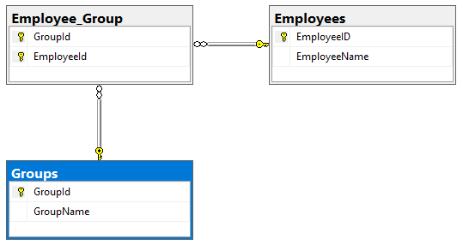
Employees can now belong to multiple groups
Graph vs Relational
EmployeeId | EmployeeName
1 | Willis B. Hawkins
2 | Neil S. Vega
3 | Ada C. Lavigne
GroupId | GroupName
1 | Engineering
2 | Sales
GroupId | EmployeeId
1 | 3
2 | 1
2 | 2

Slide 38
Employees can now belong to multiple groups
Graph vs Relational
// Add link to existing node
g.V('Sales').addE('member').to(g.V('Ada C. Lavigne’))

Slide 39
Employees can now belong to multiple groups
Graph vs Relational
EmployeeId | EmployeeName
1 | Willis B. Hawkins
2 | Neil S. Vega
3 | Ada C. Lavigne
GroupId | GroupName
1 | Engineering
2 | Sales
GroupId | EmployeeId
1 | 3
2 | 1
2 | 2
Added 2 tables; 6 rows; 4 new columns
Removed a column
+1 document

Slide 40
Employees can now belong to multiple groups
Graph vs Relational
EmployeeId | EmployeeName
1 | Willis B. Hawkins
2 | Neil S. Vega
3 | Ada C. Lavigne
SELECT Employees.EmployeeId,
Employees.EmployeeName
FROM Employees
INNER JOIN Employee_Group
ON Employee_Group.EmployeeId = Employees.EmployeeId
INNER JOIN Groups
ON Groups.GroupId = Employee_Group.GroupId
WHERE Groups.GroupName = 'Sales'
g.V('Sales').outE('member’).inV()

Slide 41

Corporate Merger
Graph Databases vs Relational Databases

Slide 42
Nested Groups
Graph vs Relational
-- Create the new Product Group
INSERT INTO Groups (GroupName) VALUES ('Product Group')

Slide 43
Nested Groups
Graph vs Relational
-- Associate everyone to the new Product Group
INSERT INTO Employee_Group (GroupId, EmployeeId)
SELECT Groups.GroupId,
Employees.EmployeeId
FROM Groups,
Employees
WHERE Groups.GroupName = 'Product Group

Slide 44
Nested Groups
Graph vs Relational
-- Create the Group/Group union table
CREATE TABLE Group_Group
(
ParentGroupId INT,
ChildGroupId INT,
CONSTRAINT pkcGroup_Group PRIMARY KEY CLUSTERED (ParentGroupId, ParentGroupId),
CONSTRAINT fkGroupGroup_Groups_Parent FOREIGN KEY (ParentGroupId) REFERNCES Groups(GroupId),
CONSTRAINT fkGroupGroup_Groups_Child FOREIGN KEY (ChildGroupId) REFERNCES Groups(GroupId)
)

Slide 45
Nested Groups
Graph vs Relational
-- Relate the child groups to the parent group
INSERT INTO Group_Group (ParentGroupId, ChildGroupId)
SELECT (SELECT GroupId FROM Groups WHERE GroupName = 'Product Group’),
Groups.GroupId
FROM Groups
WHERE Groups.GroupName <> 'Product Group’

Slide 46
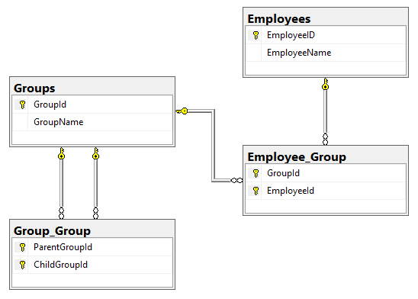
Nested Groups
Graph vs Relational
EmployeeId | EmployeeName
1 | Willis B. Hawkins
2 | Neil S. Vega
3 | Ada C. Lavigne
GroupId | EmployeeId
1 | 3
2 | 1
2 | 2
2 | 3
3 | 1
3 | 2
3 | 3
GroupId | GroupName
1 | Engineering
2 | Sales
3 | Product Group
ParentGroupId | ChildGroupId
3 | 1
3 | 2

Slide 47
Nested Groups
Graph vs Relational
// Add supergroup node
g.addV('group').property('id', 'Product Group')
// Link to adjacent nodes
g.V('Product Group').addE('contains_subgroup').to(g.V('Engineering’))
g.V('Product Group').addE('contains_subgroup').to(g.V('Sales'))

Slide 48
Nested Groups
Graph vs Relational
EmployeeId | EmployeeName
1 | Willis B. Hawkins
2 | Neil S. Vega
3 | Ada C. Lavigne
GroupId | EmployeeId
1 | 3
2 | 1
2 | 2
2 | 3
3 | 1
3 | 2
3 | 3
GroupId | GroupName
1 | Engineering
2 | Sales
3 | Product Group
ParentGroupId | ChildGroupId
3 | 1
3 | 2
Added 1 table; 6 rows; 2 new columns
+3 documents

Slide 49
Nested Groups
Graph vs Relational
GroupId | GroupName
1 | Engineering
2 | Sales
g.V('Product Group’)
.outE('contains_subgroup’)
.inV()
SELECT Groups.GroupId,
Groups.GroupName
FROM Groups
INNER JOIN Group_Group
ON Group_Group.ChildGroupId = Groups.GroupId
WHERE Group_Group.ParentGroupId =
(SELECT GroupId
FROM Groups
WHERE GroupName = 'Product Group')

Slide 50

Management
Graph Databases vs Relational Databases

Slide 51
Additional Hierarchies
Graph vs Relational
-- Create the Employee/Employee join table
CREATE TABLE Employee_Employee
(
ParentEmployeeId INT,
ChildEmployeeId INT,
CONSTRAINT pkcEmployeeEmployee PRIMARY KEY CLUSTERED (ParentEmployeeId, ChildEmployeeId),
CONSTRAINT fkEmployeeEmployee_Employee_Parent FOREIGN KEY (ParentEmployeeId) REFERENCES Employees(EmployeeId),
CONSTRAINT fkEmployeeEmployee_Employee_Child FOREIGN KEY (ChildEmployeeId) REFERENCES Employees(EmployeeId)
)

Slide 52
Additional Hierarchies
Graph vs Relational
-- Make Ada the boss
INSERT INTO Employee_Employee (ParentEmployeeId, ChildEmployeeId)
SELECT (SELECT EmployeeId FROM Employees WHERE EmployeeName = 'Ada C. Lavigne'),
EmployeeId
FROM Employees
WHERE EmployeeId IN (SELECT EmployeeId
FROM Employee_Group
WHERE Employee_Group.GroupId = (SELECT GroupId
FROM Groups
WHERE GroupName = 'Sales'))

Slide 53
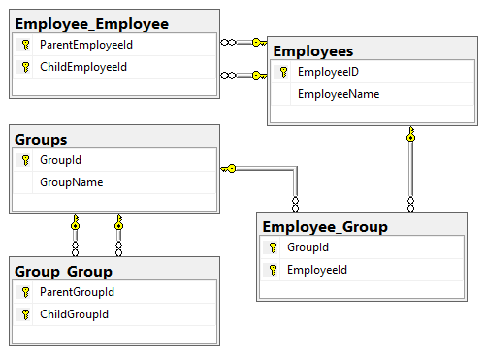
Additional Hierarchies
Graph vs Relational
EmployeeId | EmployeeName
1 | Willis B. Hawkins
2 | Neil S. Vega
3 | Ada C. Lavigne
GroupId | EmployeeId
1 | 3
2 | 1
2 | 2
2 | 3
3 | 1
3 | 2
3 | 3
GroupId | GroupName
1 | Engineering
2 | Sales
3 | Product Group
ParentGroupId | ChildGroupId
3 | 1
3 | 2
ParentEmployeeId | ChildEmployeeId
3 | 1
3 | 2
3 | 3

Slide 54
Additional Hierarchies
Graph vs Relational
// Add relationships
g.V('Ada C. Lavigne').addE('has_report').to(g.V('Willis B. Hawkins'))
g.V('Ada C. Lavigne').addE('has_report').to(g.V('Neil S. Vega'))

Slide 55
Additional Hierarchies
Graph vs Relational
EmployeeId | EmployeeName
1 | Willis B. Hawkins
2 | Neil S. Vega
3 | Ada C. Lavigne
GroupId | EmployeeId
1 | 3
2 | 1
2 | 2
2 | 3
3 | 1
3 | 2
3 | 3
GroupId | GroupName
1 | Engineering
2 | Sales
3 | Product Group
ParentEmployeeId | ChildEmployeeId
3 | 1
3 | 2
3 | 3
ParentGroupId | ChildGroupId
3 | 1
3 | 2
Added 1 table; 2 rows; 2 new columns
+2 documents

Slide 56
Additional Hierarchies
Graph vs Relational
EmployeeName
Ada C. Lavigne
Ada C. Lavigne
SELECT DISTINCT EmployeeName
FROM Employees
INNER JOIN Employee_Group
ON Employee_Group_EmployeeId
= Employes.EmployeeId
INNER JOIN Employee_Employee
ON Employee_Employee.ParentEmployeeId
= Employees.EmployeeId
WHERE Employee_Group.GroupId =
(SELECT GroupId
FROM Groups
WHERE GroupName = ‘Engineering')
g.V('Engineering’)
.outE('member’)
.inV()
.outE('has_report’)
.values('id')

Slide 57
Challenges of Relational Databases
Schema Management
Table Alternations
Costly Writes Against Multiple Tables
Multiple JOIN Operations
Complex Read Queries
Notes:
Graphs are composed of vertices and edges
Vertices represent specific objects such as a person, place, or event
An edge is a relation between vertices.
Both vertices and edges can have any number of properties
Graphs are very useful to understand a wide range of datasets in different fields such as science and business. Graph databases let you work with graphs naturally and efficiently, and they typically are NoSQL because of their ability to adjust quickly to new or updated schemas.
Graphs allow you to work with data in a powerful way by leveraging graph traversals found in many use cases and patterns because they outperform traditional SQL and NoSQL databases by several order of magnitude. Also, they open the door to querying in a natural way of speaking, such as “find the names of the students that attended the Chicago Bulls basketball exhibition game last summer.”

Slide 58
What is Gremlin
Graphing Your Way Through the Cosmos

Slide 59
What is TinkerPop
Open source, vendor-agnostic, graph computing framework
Notes:
Apache TinkerPop is an open source, vendor-agnostic, graph computing framework <CLICK> distributed under the commercial friendly Apache2 license.

Slide 60
What is TinkerPop
Apace2 license
Open source, vendor-agnostic, graph computing framework
Notes:
Apache TinkerPop is an open source, vendor-agnostic, graph computing framework <CLICK> distributed under the commercial friendly Apache2 license
<CLICK> When a data system is TinkerPop-enabled, its users are able to model their domain as a graph and analyze that graph using the Gremlin graph traversal language.
<CLICK> Furthermore, all TinkerPop-enabled systems integrate with one another allowing them to easily expand their offerings as well as allowing users to choose the appropriate graph technology for their application. This allows for different needs to be addressed by different vendors.

Slide 61
What is TinkerPop
Apace2 license
Model domain as graph and analyze using Gremlin
TinkerPop-enabled systems integrate with one another
Open source, vendor-agnostic, graph computing framework
Notes:
Apache TinkerPop is an open source, vendor-agnostic, graph computing framework <CLICK> distributed under the commercial friendly Apache2 license
<CLICK> When a data system is TinkerPop-enabled, its users are able to model their domain as a graph and analyze that graph using the Gremlin graph traversal language.
<CLICK> Furthermore, all TinkerPop-enabled systems integrate with one another allowing them to easily expand their offerings as well as allowing users to choose the appropriate graph technology for their application. This allows for different needs to be addressed by different vendors.

Slide 62
What is TinkerPop
Gremlin
Programming Interfaces
Gremlin Console
Documentation
Gremlin Server
Useful Recipes
TinkerGraph
Notes:
The project includes the following components:
Gremlin – A graph traversal (query) language
Gremlin Console – An interactive shell for working with local or remote graphs
Gremlin Server – Allows hosting of graphs remotely via an HTTP/Web Sockets connection
TinkerGraph – A small in-memory graph implementation that is great for learning
Programming Interfaces – A set of programming interfaces written in Java
Documentation – A user guide, a tutorial, and programming API documentation
Useful Recipes – A set of examples or “recipes” showing how to perform common graph oriented tasks using Gremlin queries

Slide 63

What is Gremlin
Graph traversal language and virtual machine
Supports OLTP and OLAP
Supports imperative and declarative querying
Supports user-defined domain specified languages
Notes:
Gremlin is a graph traversal language and virtual machine developed by Apache TinkerPop.
Gremlin works for both OLTP-based graph databases as well as OLAP-based graph processors
OLTP – Online Transaction Processing; OLAP – Online analytical processing
Gremlin’s automata and functional language foundation enable Gremlin to naturally support imperative and declarative querying, host language agnosticism, user-defined domain specific languages, an extensible compiler/optimizer, single- and multi-machine execution modes, hybrid depth-and breadth-first evaluation, as well as Turing Completeness.

Slide 64
What is Cosmos DB
Graphing Your Way Through the Cosmos

Slide 65
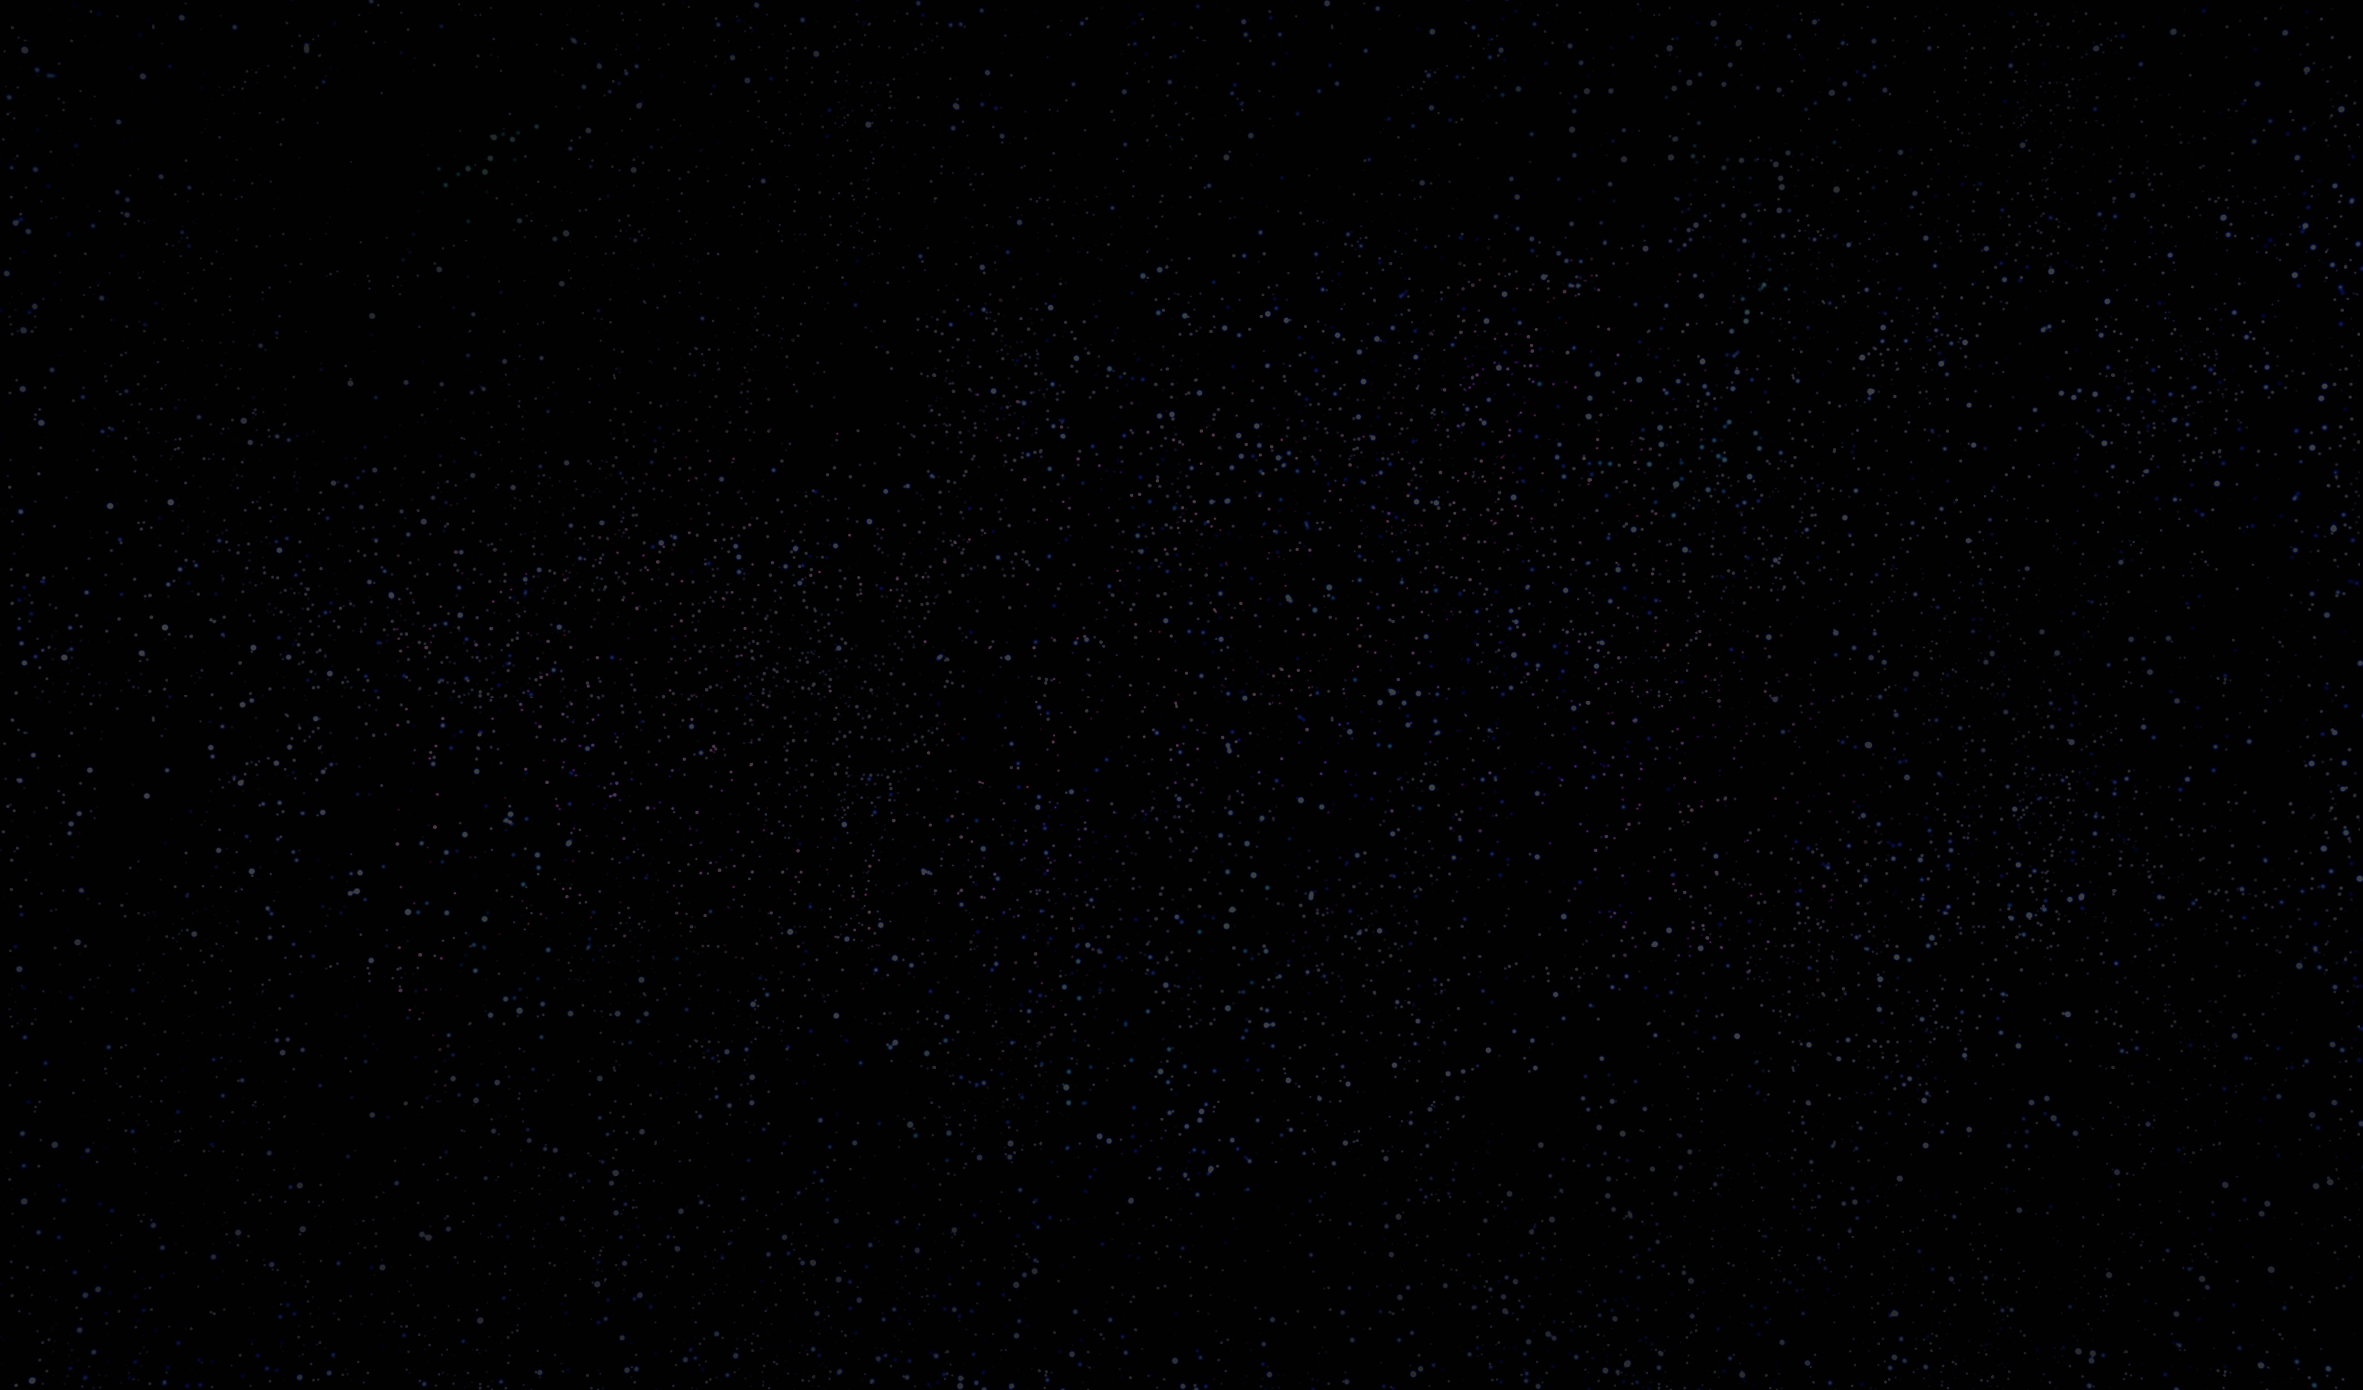

Azure Cosmos DB
A globally distributed, massively scalable, multi-model database service
Turnkey global distribution
Notes:
Turnkey Global Distribution
Enables you to build highly responsive and highly available applications worldwide
Transparently replicates your data wherever your users are, so your users can interact with a replica of the data that is closest to them
Add or remove any of the Azure regions to your Cosmos account at any time, with a click of a button
Cosmos DB will seamlessly replicate your data to all the regions associated with your account while your application continues to be highly available, thanks to the multi-homing capabilities
Always On
By virtue of deep integration with Azure infrastructure and transparent multi-master replication, Cosmos DB provides 99.999% high availability for both reads and writes.
Provides you the ability to programmatically or via Portal invoke the regional failover of your Cosmos account
Helps ensure that your application is designed to failover in the case of regional disaster

Slide 66
Azure Cosmos DB
A globally distributed, massively scalable, multi-model database service
Turnkey global distribution
Notes:
NEXT: Elastic scale out of storage & throughput

Slide 67
Azure Cosmos DB
A globally distributed, massively scalable, multi-model database service
Elastic scale out of storage & throughput
Turnkey global distribution
Notes:
Elastic scalability of throughput and storage, worldwide
Designed with transparent horizontal partitioning and multi-master replication
Offers unprecedent elastic scalability for your writes and reads, all around the globe
Elastically scale up from thousands to hundreds of millions of requests per second around the global with a single API call and pay only for the throughput (and storage) you need
Helps you deal with unexpected spikes in your workloads without having to over-provision for the peak

Slide 68
Azure Cosmos DB
A globally distributed, massively scalable, multi-model database service
Elastic scale out of storage & throughput
Turnkey global distribution
Notes:
NEXT: Guaranteed low latency at the 99th percentile

Slide 69
Azure Cosmos DB
A globally distributed, massively scalable, multi-model database service
Guaranteed low latency at the 99th percentile
Elastic scale out
of storage & throughput
Turnkey global distribution
Notes:
Guaranteed low latency at 99th percentile, worldwide
Using Cosmos DB, you can build highly responsive, planet scale applications
With its novel multi-master replication protocol and latch free and write-optimized database engine, Cosmos guarantees less than 10-ms latencies for both, reads (indexed) and writes at 99th percentile, all around the world
Capability ensures sustained ingestion of data and blazing-fast queries for highly responsive apps

Slide 70
Azure Cosmos DB
A globally distributed, massively scalable, multi-model database service
Guaranteed low latency at the 99th percentile
Elastic scale out
of storage & throughput
Turnkey global distribution
Notes:
NEXT: Five well-defined consistency models

Slide 71
Azure Cosmos DB
A globally distributed, massively scalable, multi-model database service
Five well-defined consistency models
Guaranteed low latency at the 99th percentile
Elastic scale out
of storage & throughput
Turnkey global distribution
Notes:
Strong; Bounded Staleness; Session; Consistent Prefix; Eventual

Slide 72
Azure Cosmos DB
A globally distributed, massively scalable, multi-model database service
Comprehensive
SLAs
Guaranteed low latency at the 99th percentile
Elastic scale out
of storage & throughput
Five well-defined consistency models
Turnkey global distribution
Notes:
Industry Leading Comprehensive SLAs
First and only service to offer industry-leading comprehensive SLAs encompassing 5-nine availability, read and write latency at the 99th percentile, guaranteed throughput, and consistency.

Slide 73
Azure Cosmos DB
A globally distributed, massively scalable, multi-model database service
Comprehensive
SLAs
Guaranteed low latency at the 99th percentile
Elastic scale out
of storage & throughput
Five well-defined consistency models
Turnkey global distribution

Slide 74
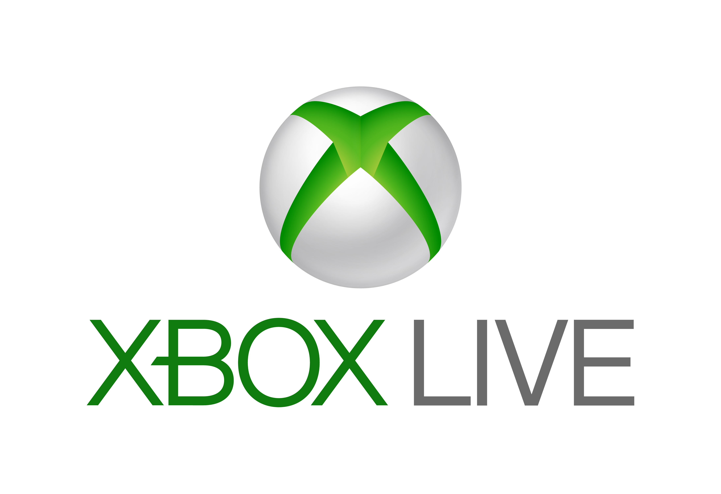

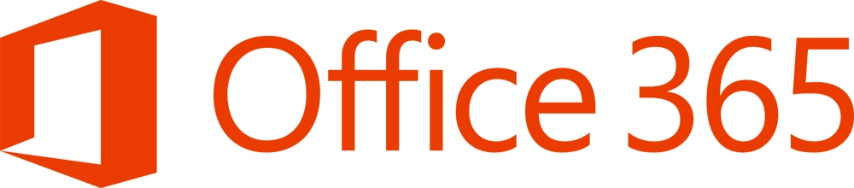

Azure Cosmos DB
A globally distributed, massively scalable, multi-model database service
Battle Tested
Guaranteed low latency at the 99th percentile
Elastic scale out
of storage & throughput
Five well-defined consistency models
Comprehensive
SLAS
Turnkey global distribution
Notes:
Battle tested database service
Cosmos DB is a foundational service in Azure
For nearly a decade, Cosmos DB has been used by many of Microsoft’s products for mission critical applications at global scale
Skype, Xbox, Office 365, Azure, and many others
One of the fastest growing services on Azure

Slide 75



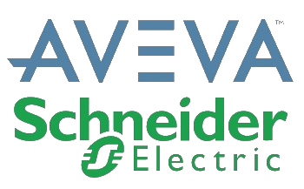







Azure Cosmos DB
A globally distributed, massively scalable, multi-model database service
Battle Tested
Guaranteed low latency at the 99th percentile
Elastic scale out
of storage & throughput
Five well-defined consistency models
Comprehensive
SLAS
Turnkey global distribution

Slide 76
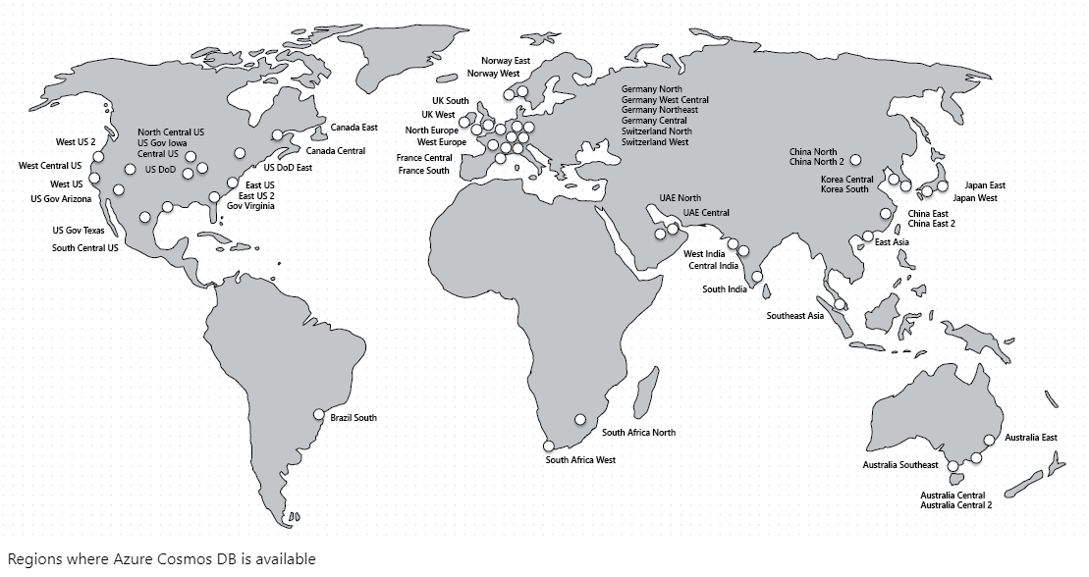
Azure Cosmos DB
A globally distributed, massively scalable, multi-model database service
Ubiquitous Regional Presence
Guaranteed low latency at the 99th percentile
Elastic scale out
of storage & throughput
Five well-defined consistency models
Comprehensive
SLAS
Turnkey global distribution
Notes:
Ubiquitous regional presence
Azure public cloud
Azure China 21Vianet (one of China’s largest internet providers)
Azure Germany (data remains in country)
Azure Government (4 regions)
Azure Government for Department of Defense (2 regions)

Slide 77
Azure Cosmos DB
A globally distributed, massively scalable, multi-model database service
Secure by default and enterprise ready
Guaranteed low latency at the 99th percentile
Elastic scale out
of storage & throughput
Five well-defined consistency models
Comprehensive
SLAS
Turnkey global distribution
Notes:
Secure by default and enterprise ready
Certified for a wide array of compliance standards
CSA STAR Certification\CSA STAR Attestation
ISO 20000-1:2011, 22301:2012, 27001:2013, 27017:2015, 27018:2014
SOC 1,2,3
DoD SRP Level 2
FedRAMP Moderate
GxP
HIPPA
HITRUST
PCI DSS
Australian IREP Unclassifed
Germany C5
Singapore MTCS Level 3
Spain ENS High
Encrypted at rest and in motion
Provides row level authorization and adheres to strict security standards

Slide 78

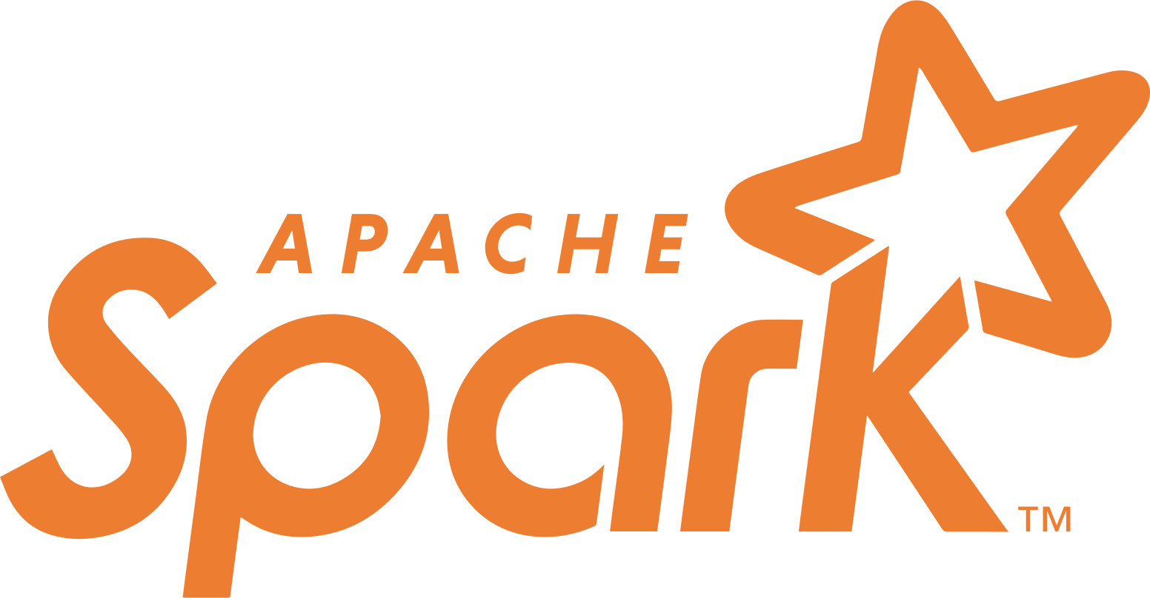


Azure Cosmos DB
A globally distributed, massively scalable, multi-model database service
Core (SQL) API
Table API
MongoDB
Column-family
Document
Key-value
Graph
Guaranteed low latency at the 99th percentile
Elastic scale out
of storage & throughput
Five well-defined consistency models
Turnkey global distribution
Comprehensive SLAs

Slide 79
Exploring Graph Traversals
Graphing Your Way Through the Cosmos

Slide 80
Requirements for Speaking Engagement Management
Where has a presentation been submitted?
What presentations are tagged with a particular tag?
Where have presentations tagged with a particular tag been accepted?
What events has a speaker been accepted at?
Where were the events a speaker has been accepted to?

Slide 81
“Schema”

Slide 82
“Schema”

Slide 83
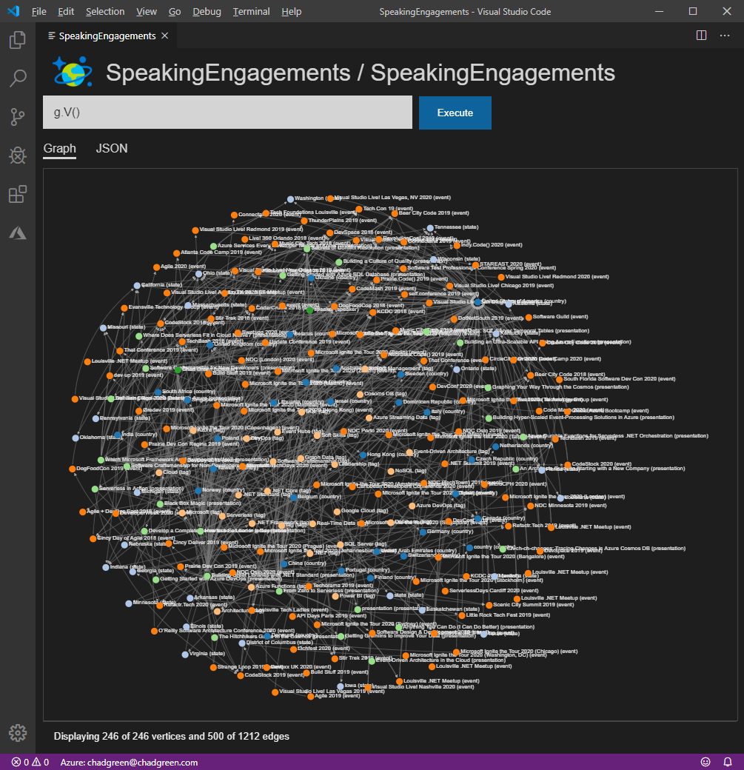
View the whole graph
g.V()

Slide 84
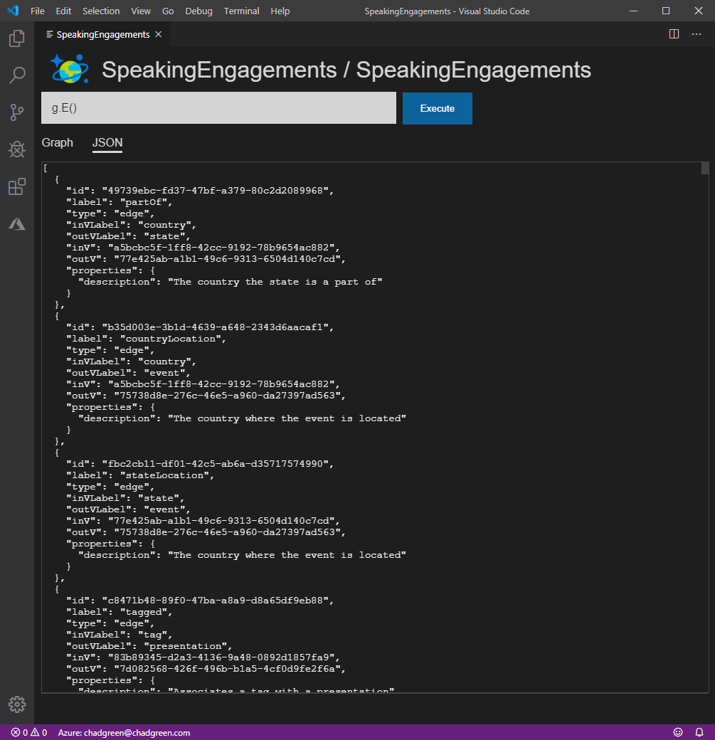
View all of the edges
g.E()

Slide 85
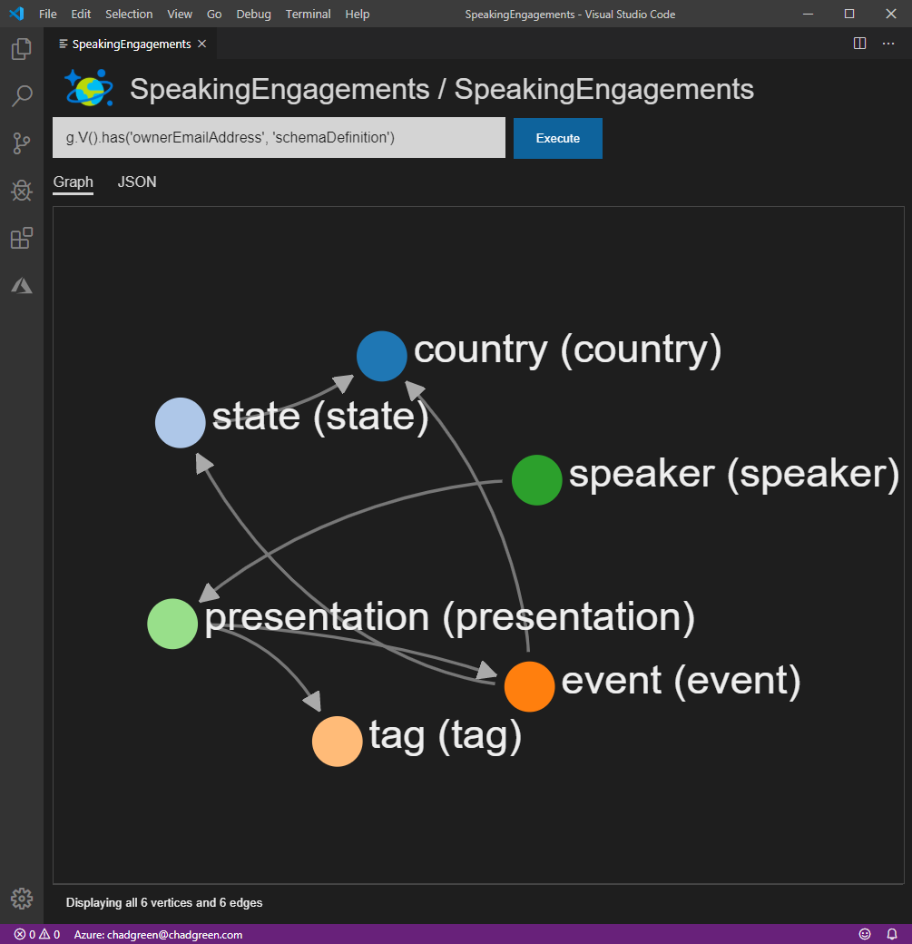
View the schema definition
g.V()
.has(‘ownerEmailAddress’, ‘schemaDefinition’)

Slide 86
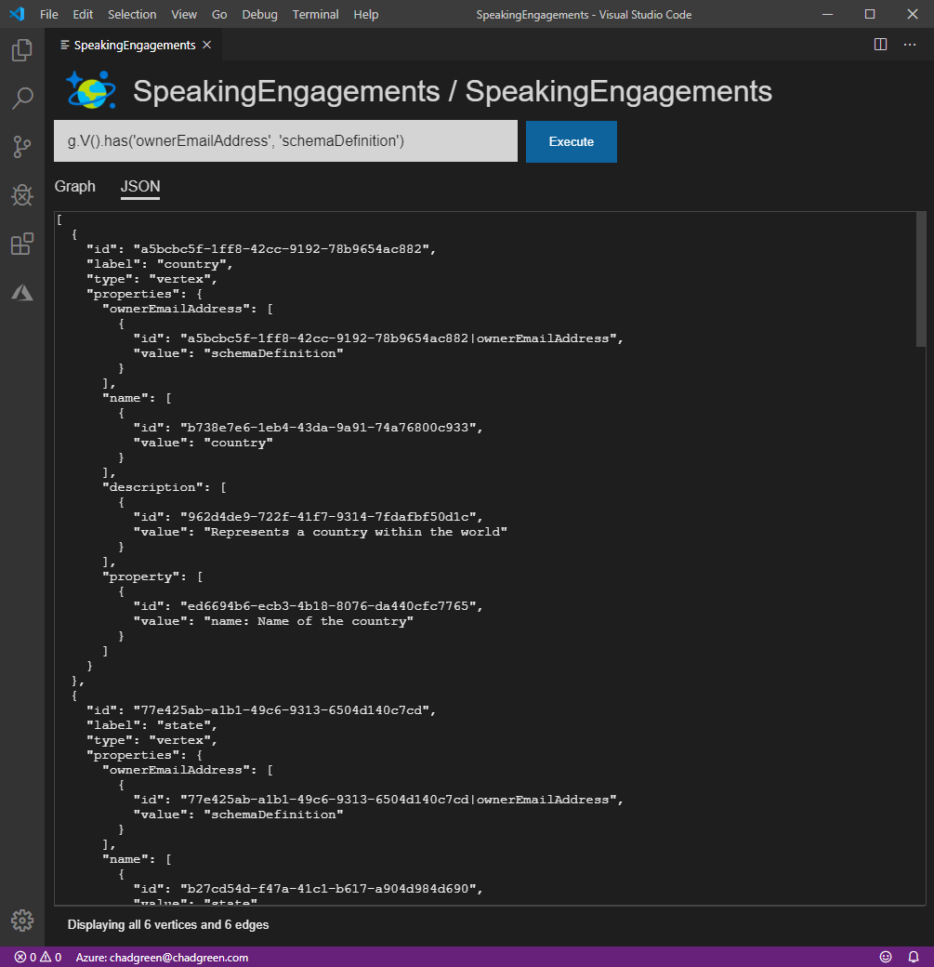
View the schema definition
g.V()
.has(‘ownerEmailAddress’, ‘schemaDefinition’)
Notes:
Next – Let’s quickly talk about how we get data in the graph

Slide 87
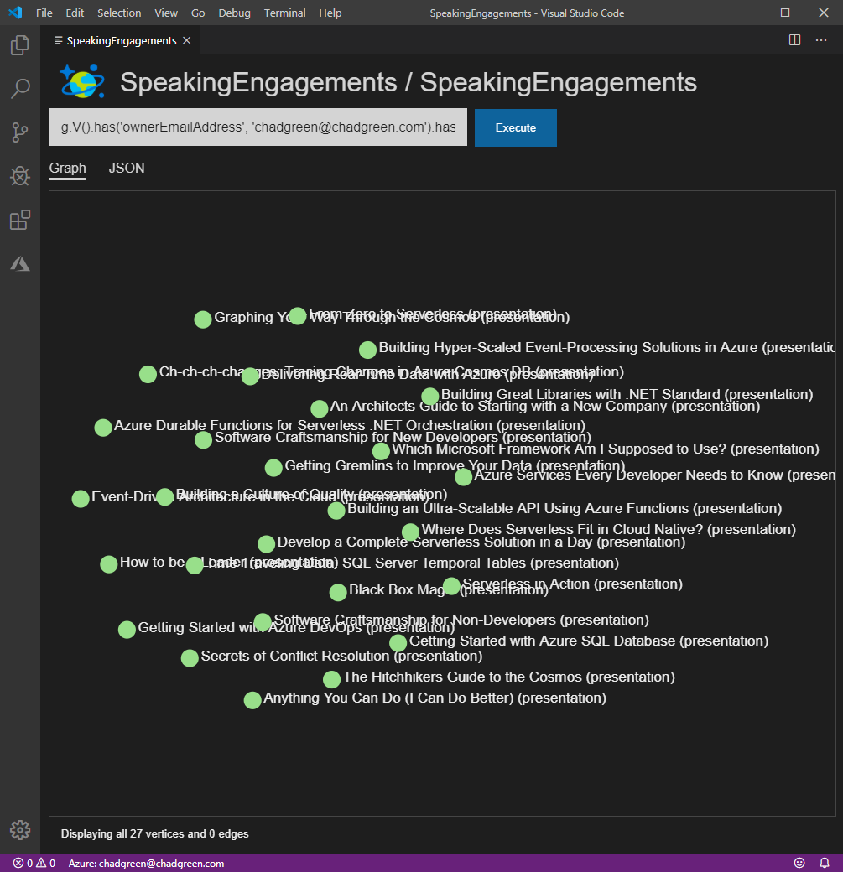
What presentations are in my repertoire?
g.V()
.has('ownerEmailAddress', 'chadgreen@chadgreen.com')
.hasLabel('presentation')

Slide 88
What presentations are in my repertoire?
g.V()
.has('ownerEmailAddress', 'chadgreen@chadgreen.com')
.hasLabel('presentation')

Slide 89
What presentations are in my repertoire?
g.V()
.has('ownerEmailAddress', 'chadgreen@chadgreen.com')
.hasLabel('presentation')

Slide 90
What presentations are in my repertoire?
g.V()
.hasLabel('presentation')

Slide 91
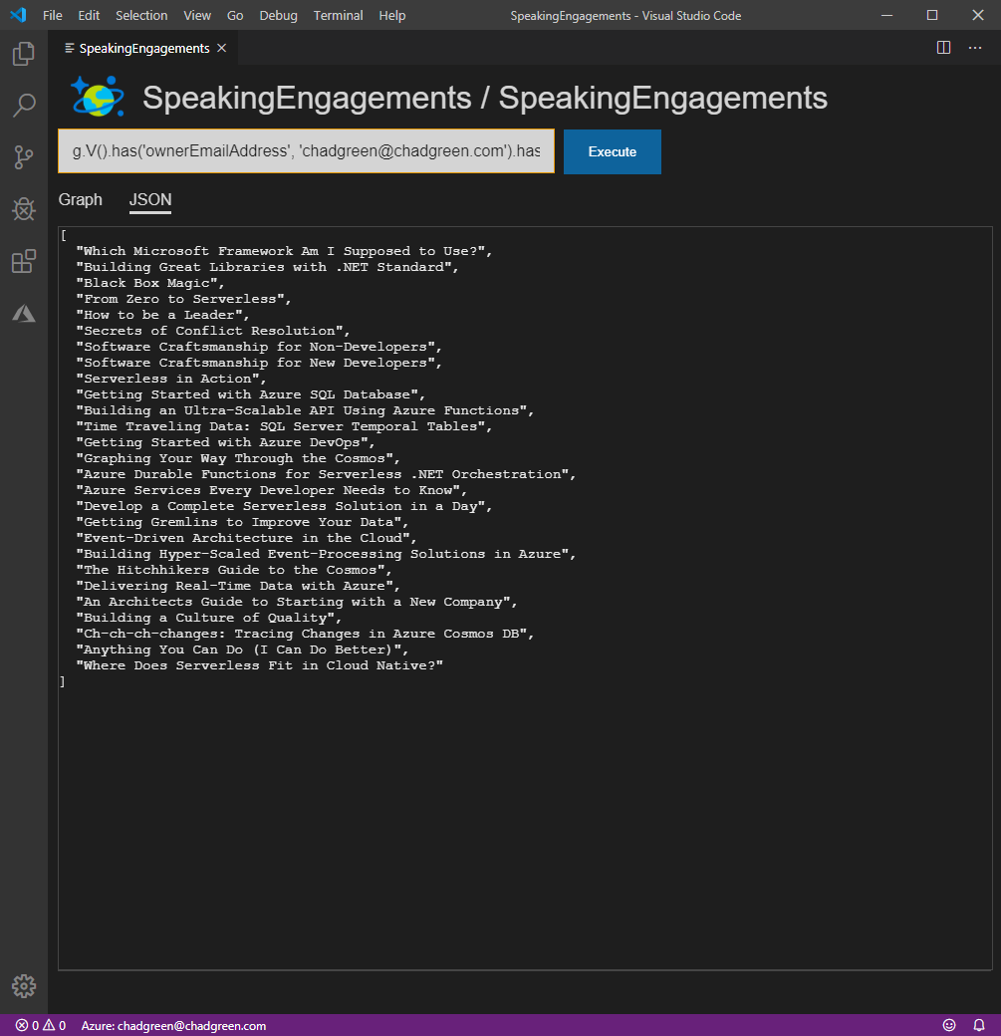
What presentations are in my repertoire?
g.V()
.hasLabel('presentation')
.values('name')

Slide 92
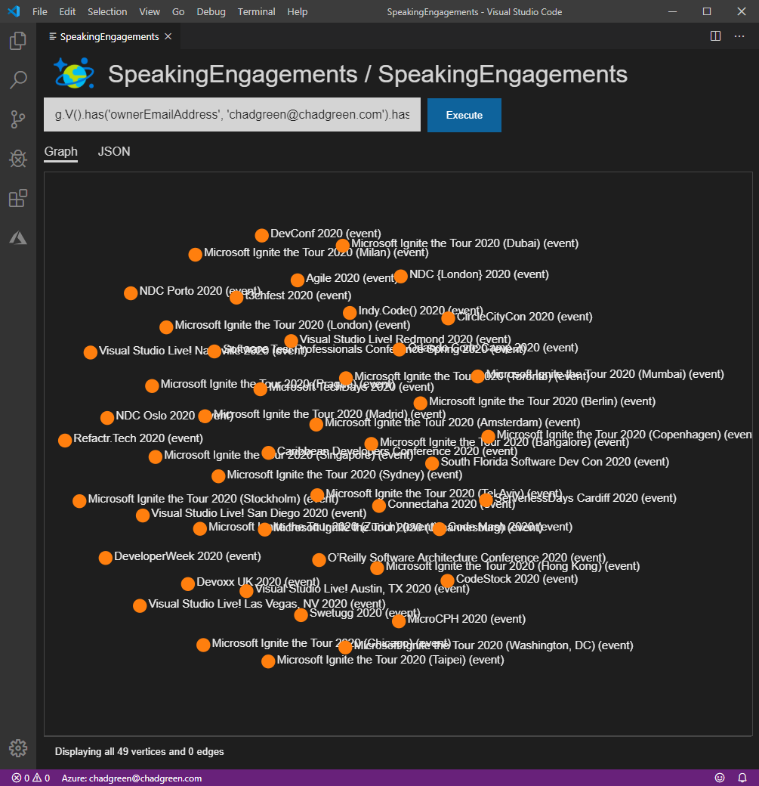
What are the events that I have submitted to?
g.V()
.hasLabel('event')
.has('year', '2020')

Slide 93
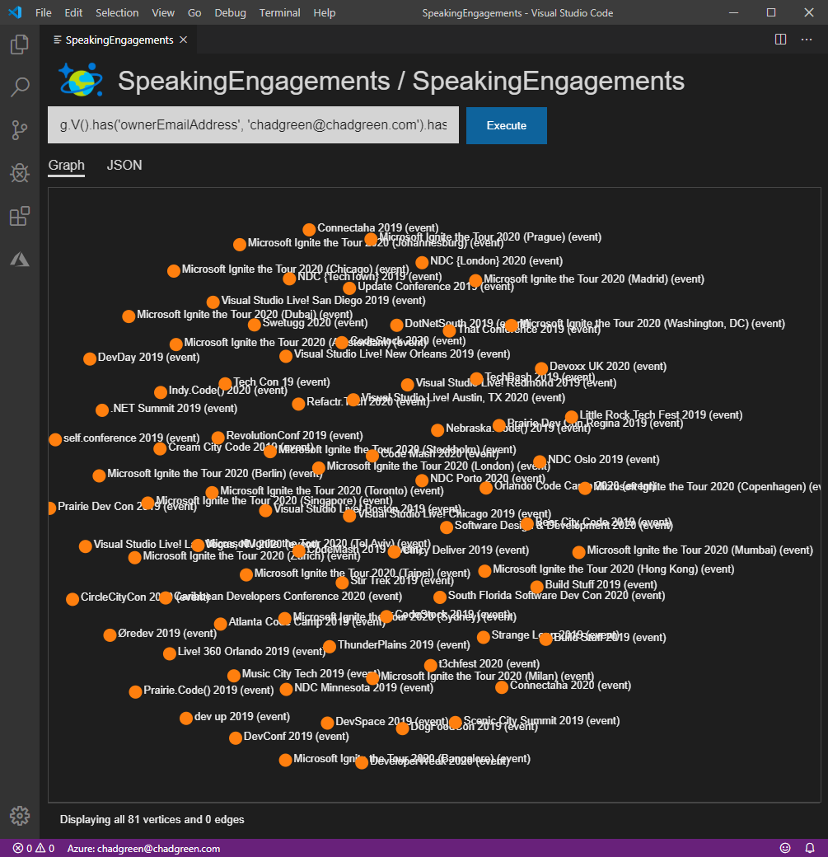
Where has Graphing Your Way Through the Cosmos been submitted to?
g.V()
.hasLabel('presentation’)
.has('name', 'Graphing Your Way Through the Cosmos’)
.outE('submittedTo’)
.inV()

Slide 94
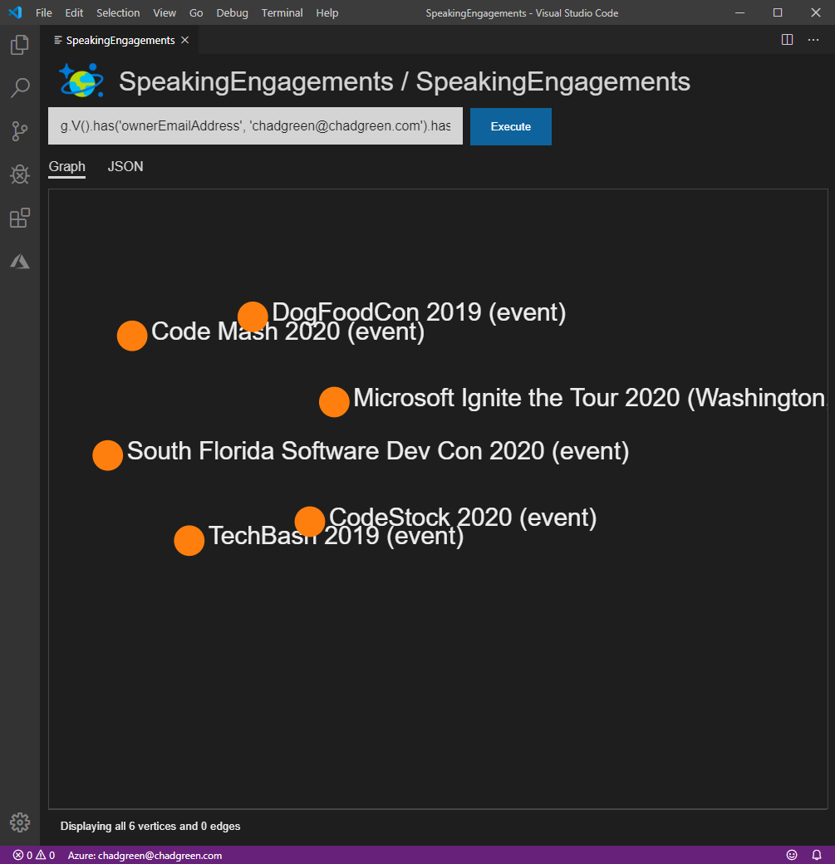
Where has Graphing Your Way Through the Cosmos been scheduled?
g.V()
.hasLabel('presentation’)
.has('name', 'Graphing Your Way Through the Cosmos’)
.outE('submittedTo’)
.has('status', 'Confirmed’)
.inV()
Notes:
6 times
DogFoodCon
TechBash
CodeMash
Microsoft Ignite the Tour – Washington DC
CodeStock
Tags up next

Slide 95
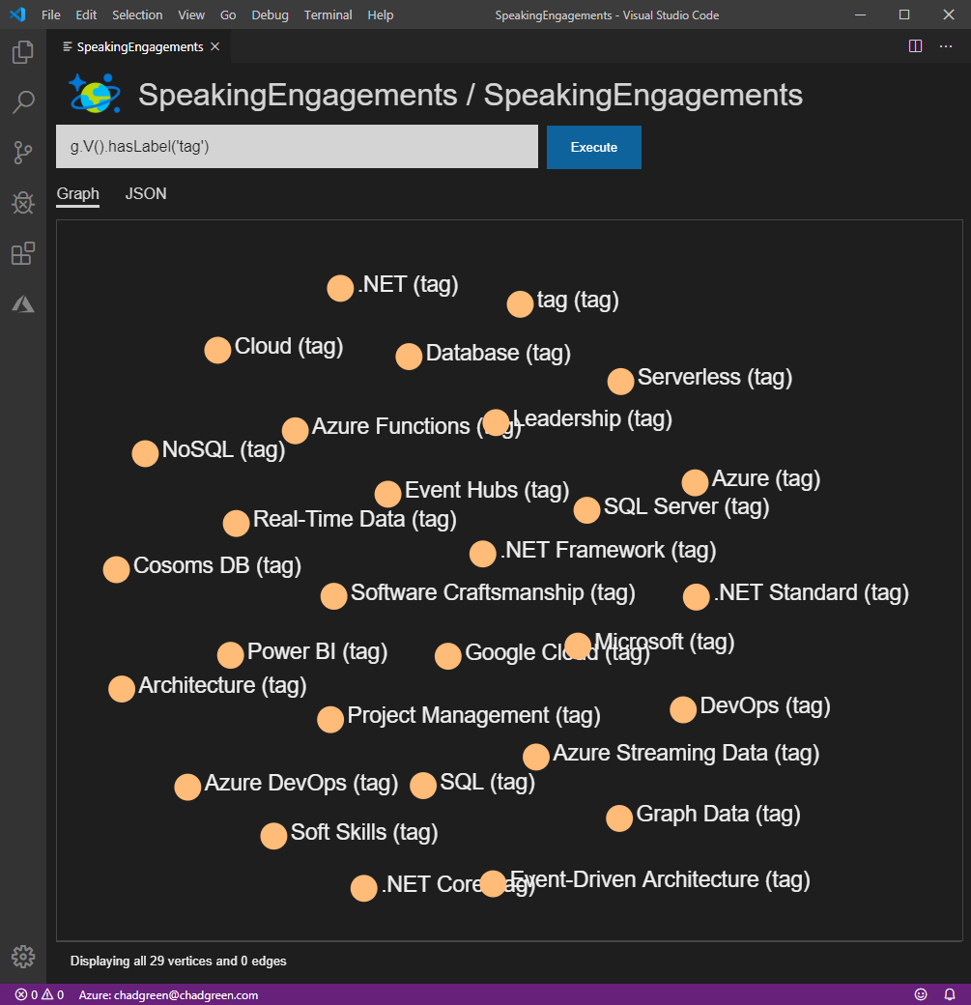
View all of the tags
g.V()
.hasLabel('tag')
Notes:
29 tags – lets focus on the Graph Data tag

Slide 96
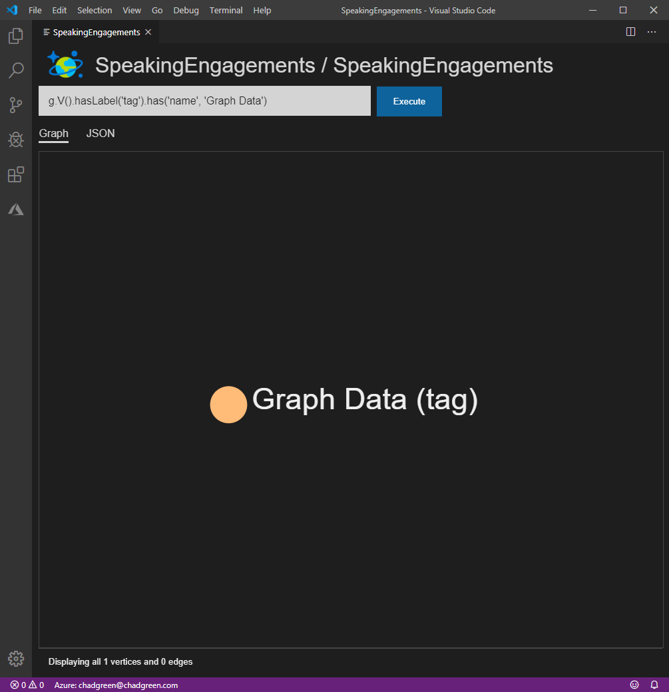
Focus on the Graph Data tag
g.V()
.hasLabel('tag’)
.has('name', 'Graph Data')
Notes:
Next – so what talks are tagged as Graph Data?

Slide 97
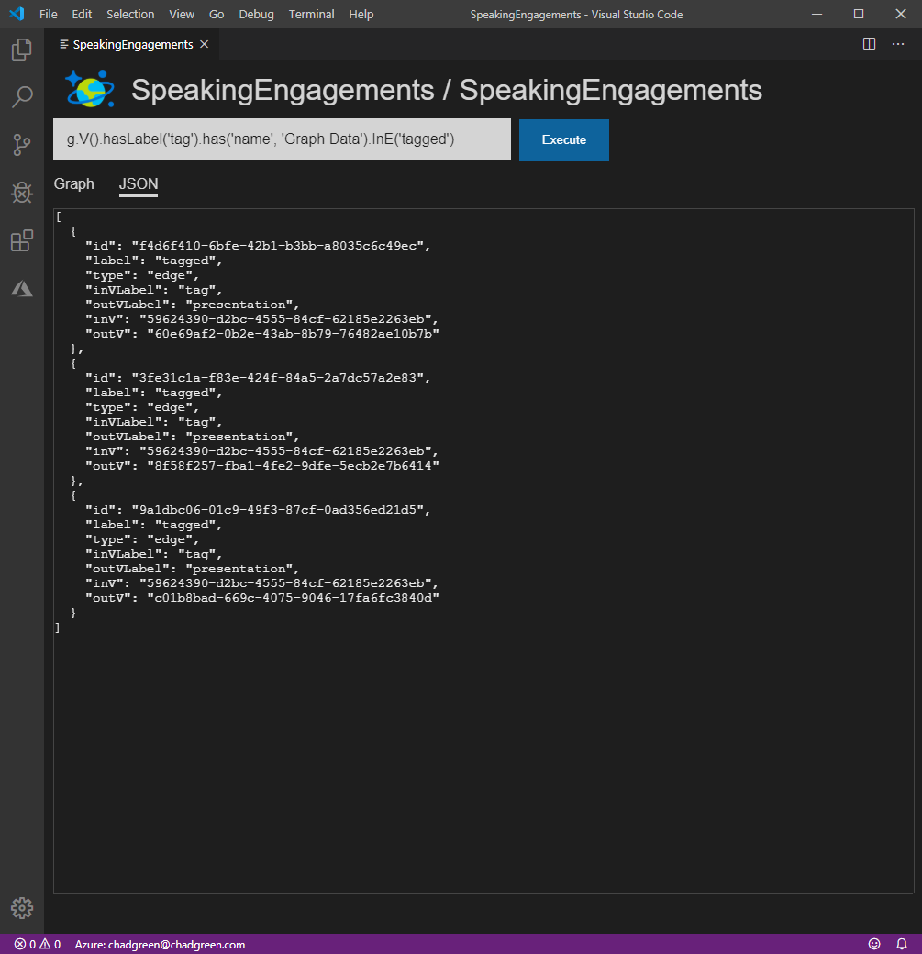
What presentations are tagged with Graph Data?
g.V()
.hasLabel('tag’)
.has('name', 'Graph Data’)
.inE('tagged')
Notes:
Just the edges first

Slide 98
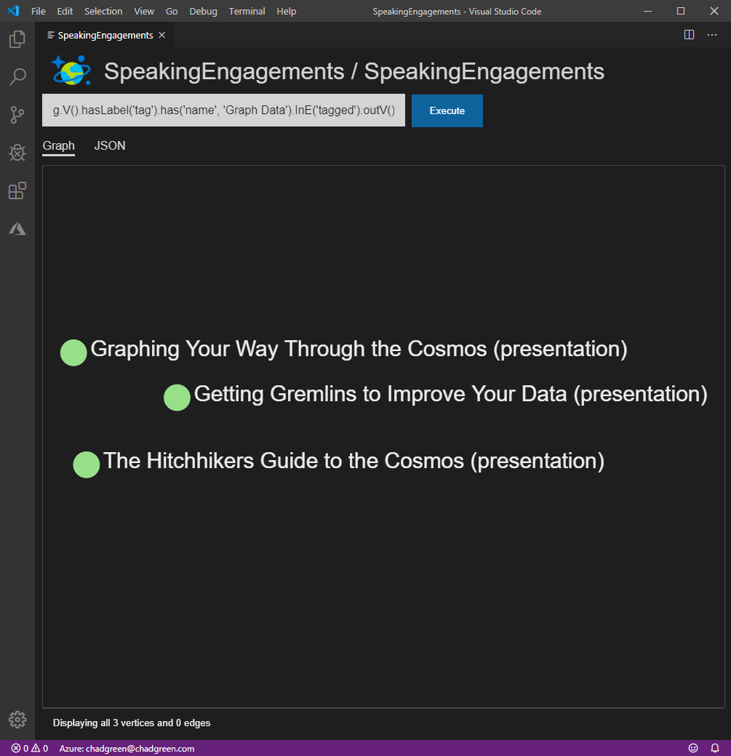
What presentations are tagged with Graph Data?
g.V()
.hasLabel('tag’)
.has('name', 'Graph Data’)
.inE('tagged’)
.outV()
Notes:
And now the vertices

Slide 99
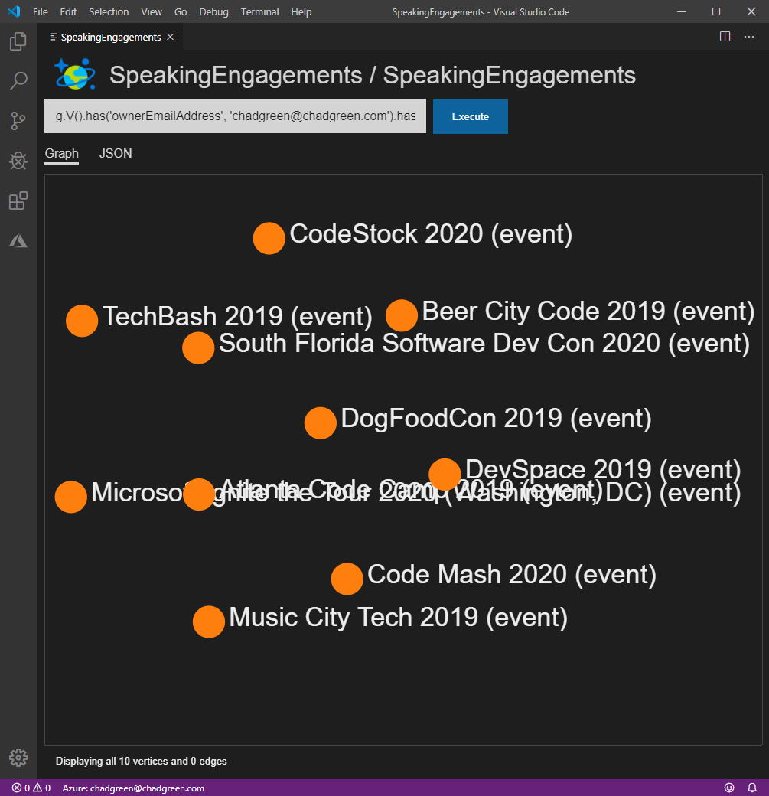
Where have presentations tagged Graph Data been scheduled?
g.V()
.hasLabel('tag’)
.has('name', 'Graph Data’)
.inE('tagged’)
.outV()
.outE('submittedTo’)
.has('status', 'Confirmed’)
.inV()
Notes:
One more walkthrough – where all have I presented in the since 2018

Slide 100
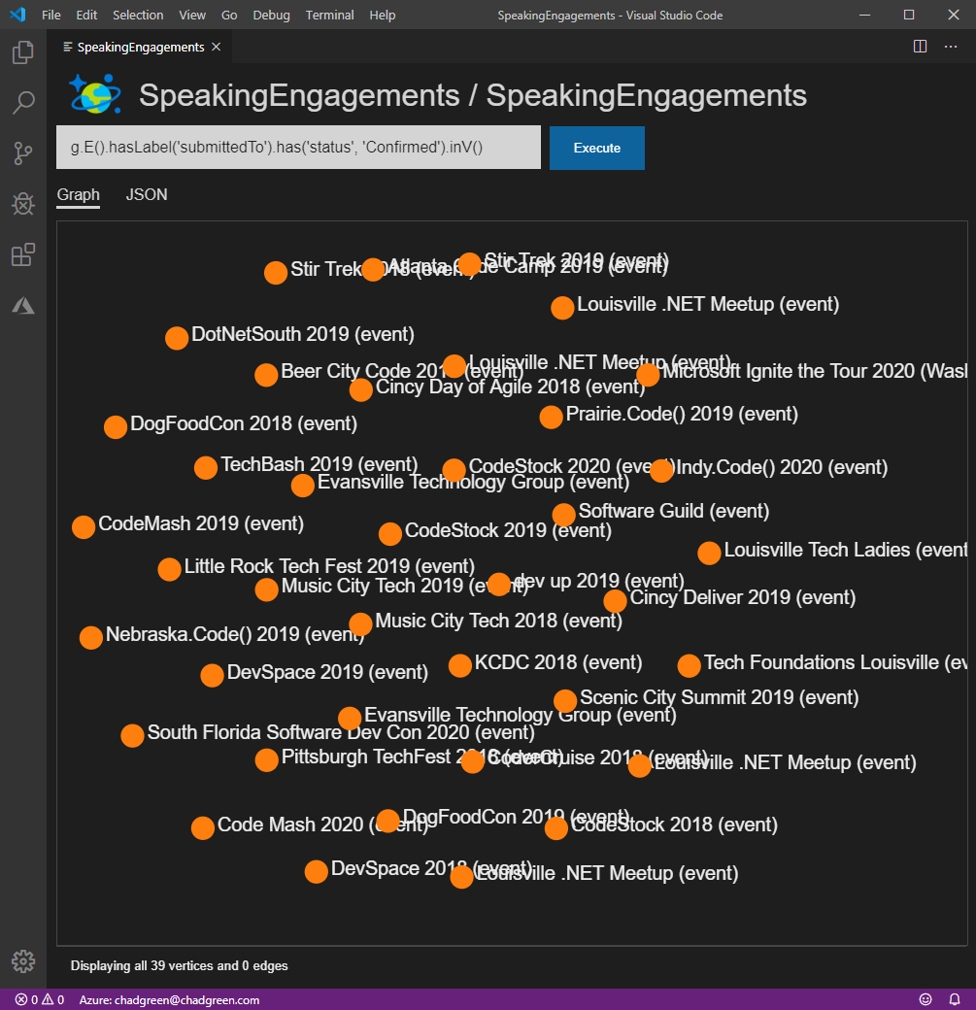
What events have I been scheduled for?
g.E()
.hasLabel('submittedTo’)
.has('status', 'Confirmed’)
.inV()
Notes:
Prior to this, we searched against Vertices; now we start our search pattern with the Edges

Slide 101
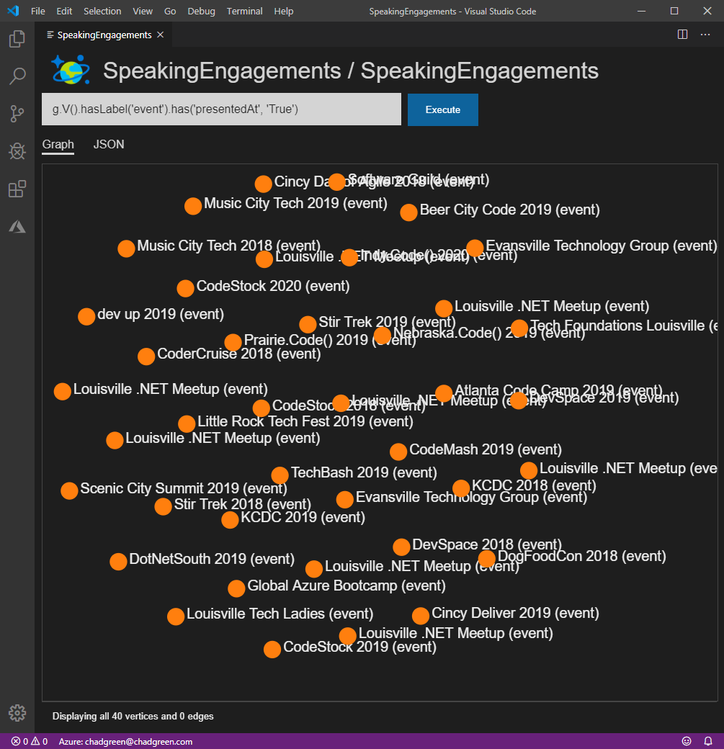
What events have I been scheduled for?
g.E()
.hasLabel('submittedTo’)
.has('status', 'Confirmed’)
.inV()
g.V()
.hasLabel(‘event’)
.has(‘presentedAt’, ‘True’)
Notes:
Because of the data structure; I have another way of look for the same data
Now let’s see what states I have spoken in

Slide 102
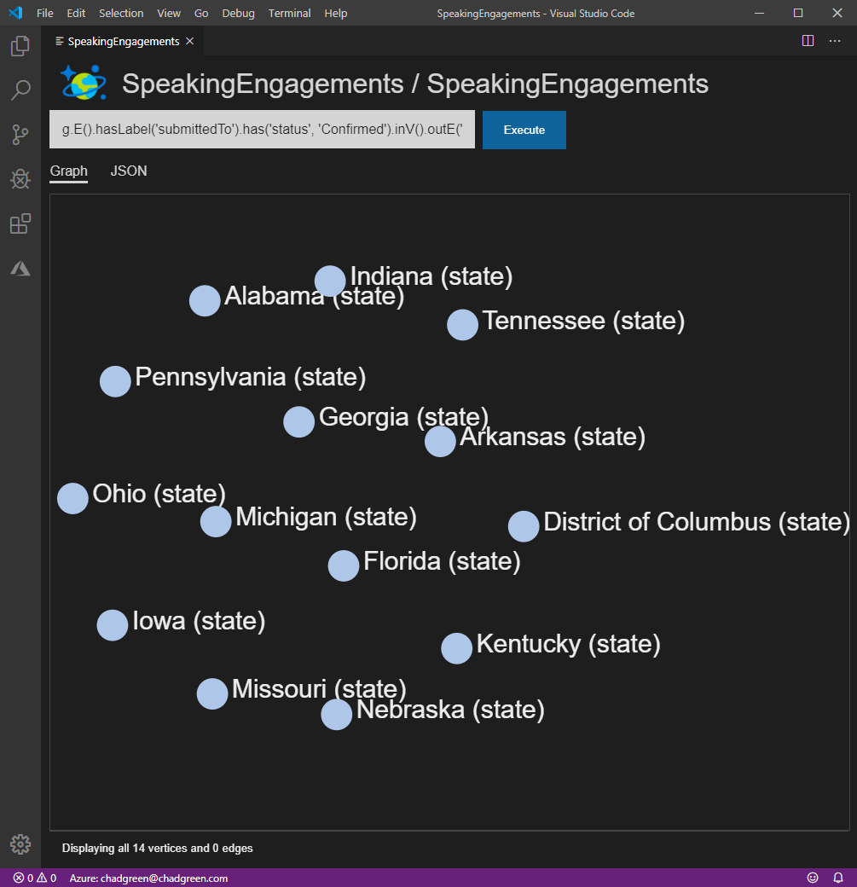
What states have I been scheduled in?
g.E()
.hasLabel('submittedTo’)
.has('status', 'Confirmed’)
.inV()
.outE('stateLocation’)
.inV()
Notes:
Alabama
Arkansas
Florida
Georgia
Indiana
Iowa
Kentucky
Michigan
Nebraska
Ohio
Pennsylvania
Tennessee
Washington, DC

Slide 103
Wrapping Up
Graphs – set of objects in which pairs are in some sense related
Graph Theory – Starts with the 7 bridges of Königsberg
Graph databases – use graph structure to represent and store data
Azure Cosmos DB – globally distributed, multi-model database service
Graph vs Relational – lots of benefits that make graph database worth a look
Graph Traversal – Navigating graph data using patterns
Notes:
In math, a graph is a structure amounting to a set of objects in which some pairs of objects are in some sense related
Graph Theory gets it start from Leonard Euler's solution of a problem relating to the geometry of position - the 7 bridges of Königsberg
In regards to data, graphs are a collection of vertices (the objects) and edges (the relationships)
A graph database is a database that uses graph structure to represent and store data
Azure Cosmos DB is a fully managed database service with turnkey global distribution and transparent multi-master replication. Get single-digit millisecond read and write latenices at the 99th percentile, automatic and elastic scaling of throughput and storage worldwide, 99.999-percent high availability, and five well-defined conistency choices.
Graph databases offer lots of benefits over relational databases
Shema management
Table alterations
Costly writes against multiple tables
Multiple JOIN operations
Complex read queries

Slide 104
Thank You!
Graphing Your Way Through the Cosmos
chadgreen@chadgreen.com
TaleLearnCode
TaleLearnCode.com
ChadGreen & TaleLearnCode
ChadwickEGreen

